Slide 1
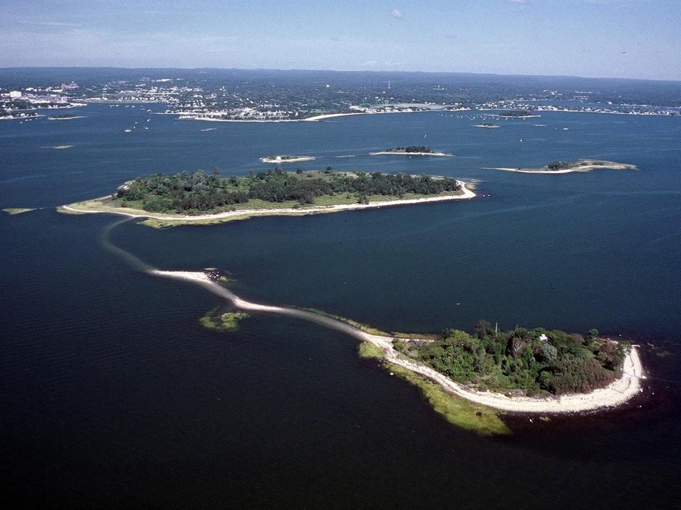
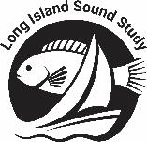
Living Treasures:
Photo: Copps Island, Norwalk; 2003 Connecticut Coastal Oblique Photos; www.lisrc.uconn.edu
The Plants and Animals of Long Island Sound
Nancy Balcom, Connecticut Sea Grant; updated 2021
Notes:
Note to Users:
This PowerPoint presentation covers the habitats associated with Long Island Sound and some of the plants and animals that inhabit them. It is based on the Connecticut Sea Grant publication, Living Treasures: The Plants and Animals of Long Island Sound, by Lisa Wahle and Nancy Balcom (CT-20-06; updated 2020), also available in Spanish (Tesoros Vivientes: Las plantas y animales del Long Island Sound; CT-20-07).
Photo credits and additional background information are provided in the Notes Page for each slide.
Many individuals generously shared their digital images with Connecticut Sea Grant for use in this PowerPoint presentation. Permission is granted to formal and informal educators for use of the images for educational purposes only; these photographs may not be reproduced commercially without permission. Photo credit must be given as indicated on the note page for each slide.
Photo: Copps Island, Norwalk; 2003 Connecticut Coastal Oblique Photos; www.lisrc.uconn.edu

Slide 2
Long Island Sound is bordered on the south by Long Island, New York and on the north and west by the coasts of Connecticut and Westchester County, New York
Map reprinted with permission from Living Treasures: The Plants and Animals of Long Island Sound by L. Wahle and N. Balcom (2020); Connecticut Sea Grant Publication No. CTSG-20-06. 48pp.
Notes:
Map reprinted with permission from Living Treasures: The Plants and Animals of Long Island Sound by L. Wahle and N. Balcom (2020); Connecticut Sea Grant Publication No. CTSG-20-06. 48pp.

Slide 3
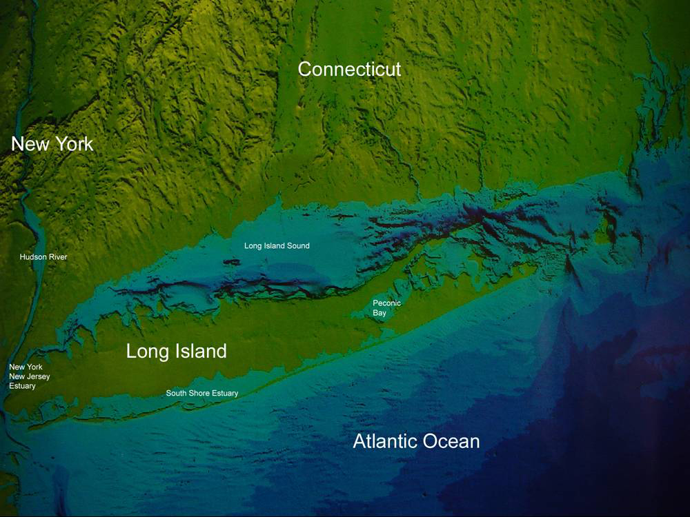
Long Island Sound is the nation’s second largest estuary – a special place where fresh water from rivers and streams and salt water from the ocean meet and mix
Notes:
The Sound is the second largest estuary in the nation, where fresh water from larger rivers (Connecticut, Thames, Housatonic, & Quinnipiac Rivers in Connecticut, and the East River in New York) as well as from many smaller rivers and tributaries, meet and mix with the salt water of the Atlantic Ocean.
Unlike most estuaries, Long Island Sound has an east-west orientation.
The watershed of Long Island Sound is approximately 16,800 square miles (43,512 sq.km). It begins in Quebec, Canada and includes sections of five states.
The Sound runs 110 miles (177 km) from the East River in the west to The Race in the east and is 21 miles (34 km) wide at its widest point near the Connecticut River; it ranges from 60 to 300 feet (18 – 92 m) at its deepest points, with an average depth of 63 feet (20 m).

Slide 4
Estuaries are among the most productive ecosystems in the world, providing feeding, breeding, nesting and nursery areas for many animals
They are water bodies of constantly changing conditions, such as temperature and salinity
Plants and animals that live in estuaries must be able to tolerate these changes; many have special adaptations that help them cope
More than 170 fish species and 1,200 invertebrate species live year-round or seasonally in Long Island Sound
Notes:
The Sound’s salinity range averages from 20 to 30 ppt; ranging from ~ 25 ppt near the East River in the far western end to ~ 30 ppt in the eastern end near The Race; the salinity in brackish marshes ranges from 0 – 18 ppt; the salinity of the water at the mouths of the rivers as they enter the Sound can be much lower due to the influence of the fresh water
Water temperature ranges from about 1ºC in the winter to as much as 22-25ºC in late summer
Photo: Great Island, mouth of Connecticut River 2003 Connecticut Coastal Oblique Photos; www.lisrc.uconn.edu

Slide 5
Habitat: It’s Where You Live
Photo: Fairfield, Connecticut; 2003 Connecticut Coastal Oblique Photos; www.lisrc.uconn.edu
Notes:
Photo: Fairfield, Connecticut; 2003 Connecticut Coastal Oblique Photos; www.lisrc.uconn.edu

Slide 6
Long Island Sound has a broad range of habitat types, which in turn support a wide variety (diversity) of plant and animal species
A habitat meets the primary needs of organisms, including food, water, air, and shelter
Primary habitat types in the Sound are:
Salt marshes
Sandy beaches
Tidal flats
Rocky intertidal
Submerged bottom
Open water

Slide 7
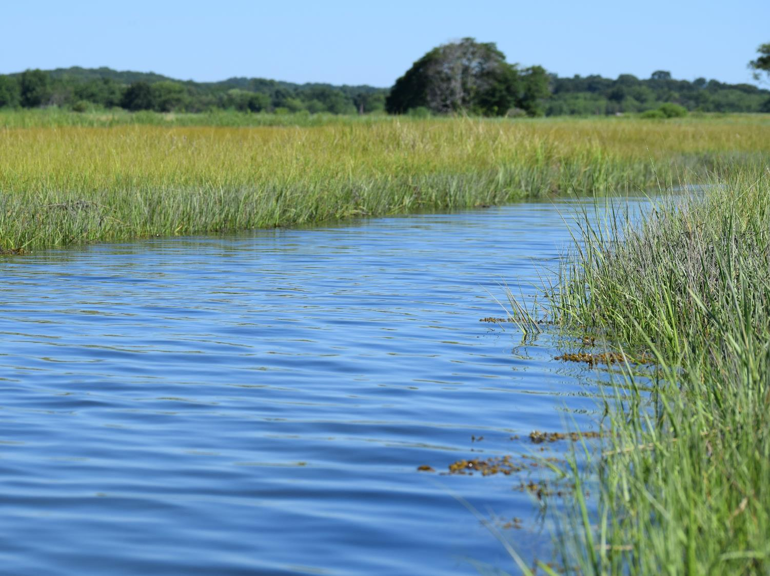
Salt Marshes: Nature’s Nurseries
Photo: Salt marsh; courtesy of Nancy Balcom
Notes:
Photo: Salt marsh; courtesy of Nancy Balcom

Slide 8
A salt marsh serves many important roles in the Sound’s ecosystem — nursery, filter, sponge, and nutrient source
Photo: Bluff Point (Groton, CT) salt marsh; courtesy of Nancy Balcom
Notes:
Fringing the shore, salt marshes and tidal wetlands provide sheltered nursery areas for many species of fish and are home to abundant prey organisms for crabs, shrimp, fish, birds, reptiles, and mammals
Forming in quiet locations where sediment can be trapped in the vegetation, salt marshes are highly productive environments, serving as a source of nutrients to the adjacent estuary
Dead and decaying salt marsh vegetation provides food for detritivores such as fiddler crabs, worms, and snails
Bacteria break the vegetation down even further, releasing nutrients back into the water
Salt marshes also filter or trap contaminants and sediments
The dense roots and peat of salt marsh grasses act as a sponge during storms, protecting the higher marsh and reducing the impact of flooding on coastal shorelines
Photo: Bluff Point (Groton, CT) salt marsh; courtesy of Nancy Balcom

Slide 9
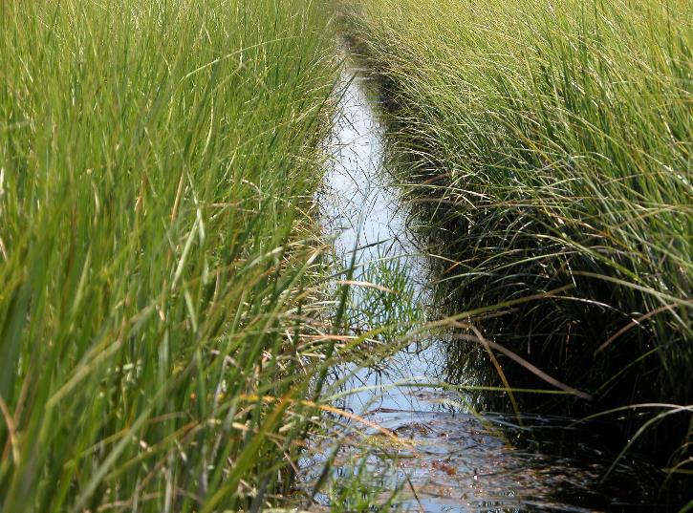
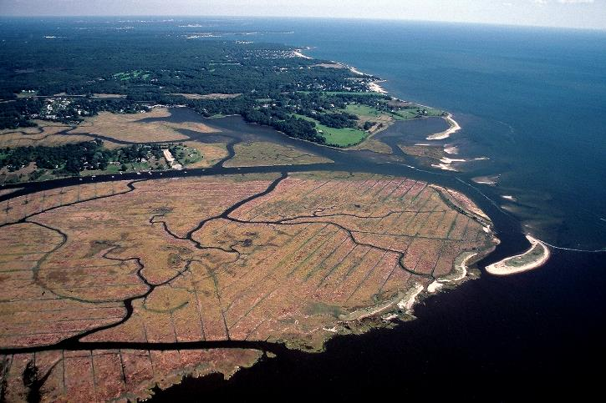
Mosquito ditches crisscross the marsh; they were originally hand-dug to combat diseases carried by mosquitoes, which breed in pools of standing water
Mosquito ditch in salt marsh, courtesy of Nancy Balcom
Poverty Point, mouth of Connecticut River; 2003 Connecticut Coastal Oblique Photos; www.lisrc.uconn.edu
Notes:
Mosquito ditches crisscross the salt marsh. These ditches were originally dug by hand to help drain salt ponds and standing water in the marshes where mosquitoes were breeding. It wasn’t until the 1950s when the important functions of salt marshes were more fully understood that ditching was discontinued.
Around the turn of the 19th century, ice boxes were used for refrigeration, and ice was needed to supply them; natural ice was harvested and stored in well-insulated ice houses until summer. Tidal marshes and shallow tributaries of the Sound, which froze during the winter, were places where ice blocks as much as two feet thick were harvested.
Photo: Poverty Point, mouth of Connecticut River; 2003 Connecticut Coastal Oblique Photos; www.lisrc.uconn.edu; Mosquito ditch in salt marsh, courtesy of Nancy Balcom

Slide 10
Salt marshes have distinct zones of vegetation determined by elevation
Tall saltmarsh cordgrass grows along the water’s edge in the low marsh, which is regularly flooded by the tides; this grass tolerates changing water level, salt concentration, and temperature
Photo: Saltmarsh cordgrass, Spartina alterniflora, and seed head; courtesy of Nancy Balcom
Notes:
The tall, coarse saltmarsh cordgrass grows at the water’s edge where few plants can tolerate the salinity
Photo: Saltmarsh cordgrass, Spartina alterniflora, and seed head; courtesy of Nancy Balcom

Slide 11
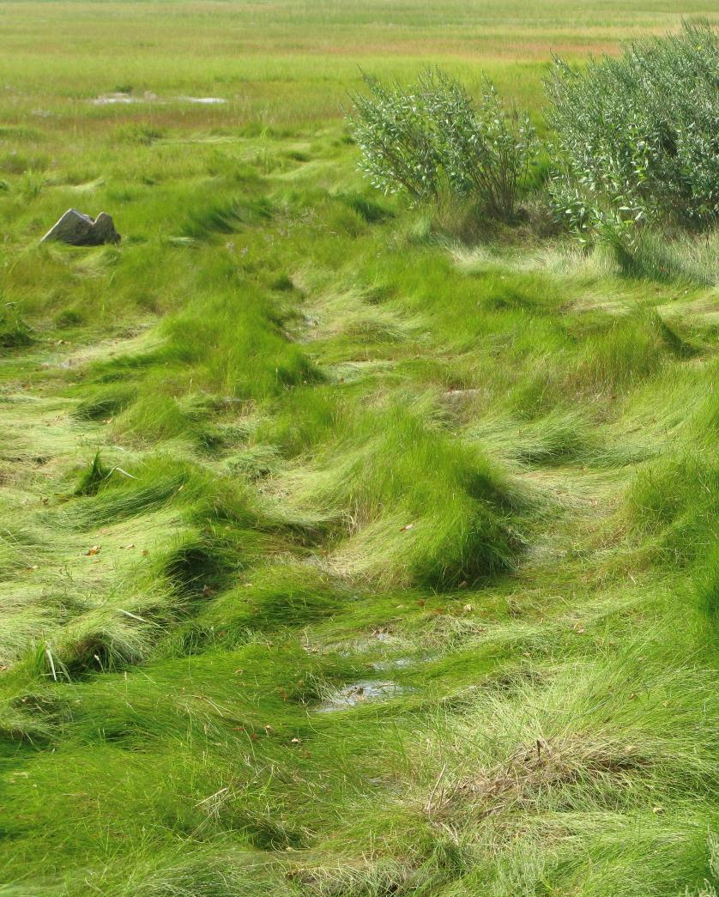
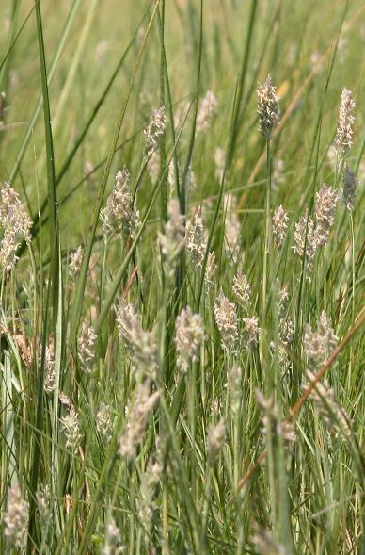
The high marsh is flooded only during storms or unusually high tides; saltmeadow cordgrass and spikegrass (inset) dominate this part of the marsh
Photo: (left) Saltmeadow cordgrass, Spartina patens, courtesy of Judy Preston; (inset) spikegrass with seed heads, Distichlis spicata; courtesy of Nancy Balcom
Notes:
Just a few inches higher in elevation than the low marsh, the high marsh is dominated by saltmeadow cordgrass and spikegrass; saltmeadow cordgrass (also called saltmarsh hay or highwater grass) has a “cowlick” appearance
The high marsh is flooded completely during spring tides, extra high and extra low tides that occur twice monthly, during the full and new moons
In early colonial times, the saltmeadow cordgrass was harvested extensively and used for hay and fed to livestock. It was also used for house insulation and even thatched roofs. Today, it is still cut and used for mulch.
The seeds of both these grasses serve as important food sources for black ducks and seaside and saltmarsh sharp-tailed sparrows.
Photo: (left) Saltmeadow cordgrass, Spartina patens, courtesy of Judy Preston; (inset) spikegrass with seed heads, Distichlis spicata; courtesy of Nancy Balcom

Slide 12
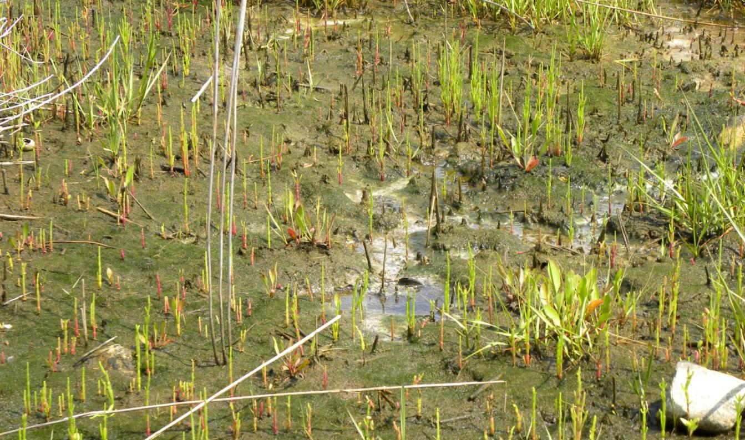
Salt pannes are small, “desert-like” depressions in the marsh, where soil salinity can reach levels that are almost twice that of full-strength sea water
Photo: salt panne; courtesy of Nancy Balcom
Notes:
Salt pannes are shallow depressions in the marsh that drain poorly; they may be created naturally by ice scouring or peat compaction or result from impoundments created by mosquito-ditching levees. Flooded by high tides, they drain slowly. The standing water evaporates, increasing the salinity of the soil. Algal mats sometimes form here as well.
Studies have shown that the soil salinities in salt pannes can reach 40-60 parts per thousand (ppt), while full strength seawater is 35 ppt, and the Sound’s salinity ranges on average between 20 and 30 ppt, depending on location
Photo: salt panne; courtesy of Nancy Balcom

Slide 13
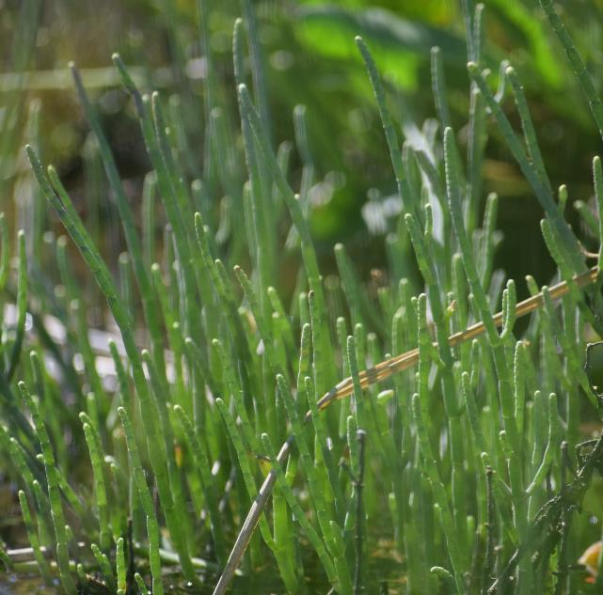
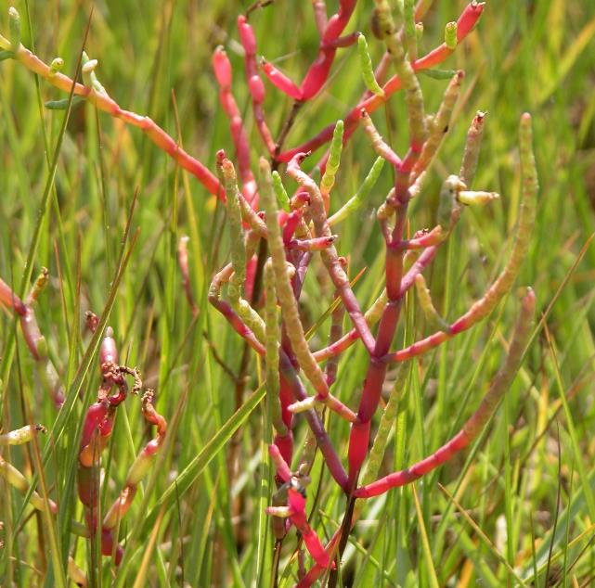
Glasswort, a succulent plant, grows in the salt pannes and along the edges of the saltmarsh, looking like a field of tiny, spineless cacti; some species turn reddish in the fall
Photos: Glasswort, Salicornia sp.; courtesy of Nancy Balcom
Notes:
“Succulent” means that the plant is able to store water in its tissues (like cactus), enabling it to maintain a critical water balance which is necessary because of the salt panne’s salty soil in which it grows; this plant’s physiology is so specialized for this habitat that it would have a hard time growing in a non-saline area
Also called saltwort or “salt plant” (wort is an old word for plant)
In the fall, some species of glasswort put on their own fall foliage display, turning reddish in color
Photos: Glasswort, Salicornia sp.; courtesy of Nancy Balcom

Slide 14
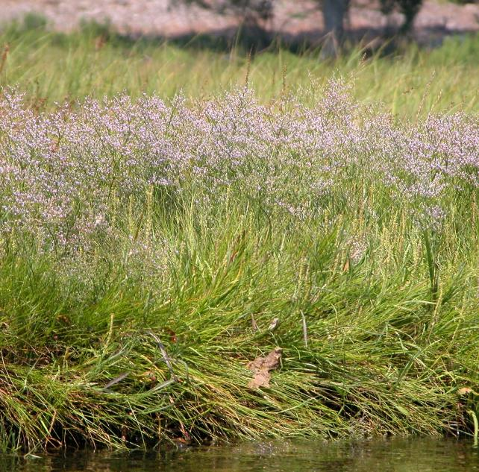
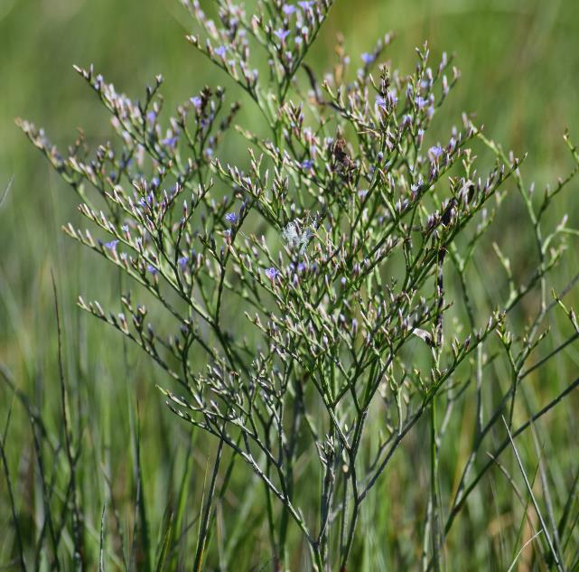
Sea lavender, with its delicate purple flowers and wiry stems, grows in salt pannes and the low marsh
Photo: Sea lavender and flower inset, Limonium carolinianum; courtesy of Nancy Balcom
Notes:
At one time, sea lavender was collected for dried flower arrangements. This is no longer legal.
Photo: Sea lavender and flower inset, Limonium carolinianum; courtesy of Nancy Balcom

Slide 15
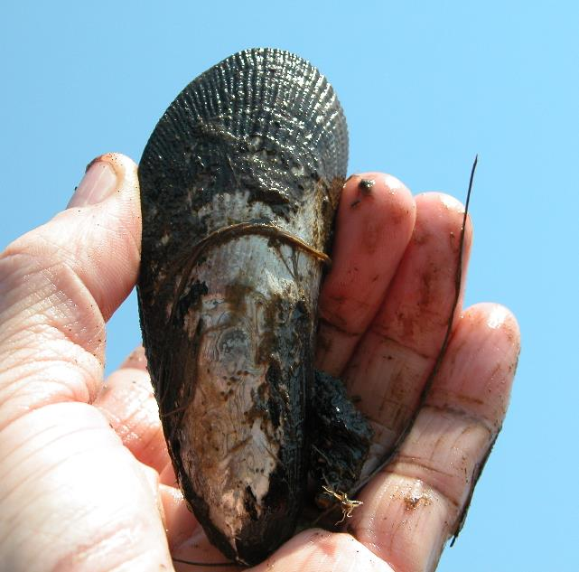
Ribbed mussels grow along the edges of tidal creeks in salt marshes, providing food for terrestrial mammals and other organisms
Photos: Ribbed mussels, Geukensia demissa; courtesy of Nancy Balcom
Notes:
Unlike blue mussels, humans tend not to eat ribbed mussels; they have a very muddy taste.
Photos: Ribbed mussels, Geukensia demissa; courtesy of Nancy Balcom

Slide 16
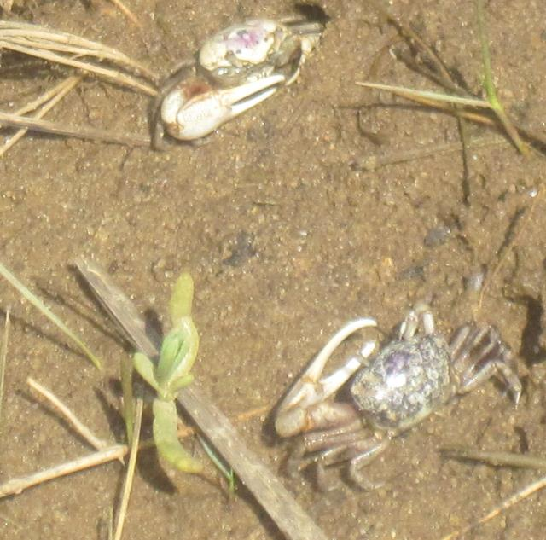
Fiddler crabs burrow into the sand, mud and peat at edges of saltmarshes; male crabs have one greatly enlarged right or left pincer for combat and mating rituals; the claws of females are about equal in size
Photos: (left) Unidentified species of fiddler crab and (right) burrows in saltmarsh peat (Old Lyme CT); courtesy of Nancy Balcom
Notes:
Photos: (left) Unidentified species of fiddler crab and (right) burrows in saltmarsh peat (Old Lyme CT); courtesy of Nancy Balcom

Slide 17
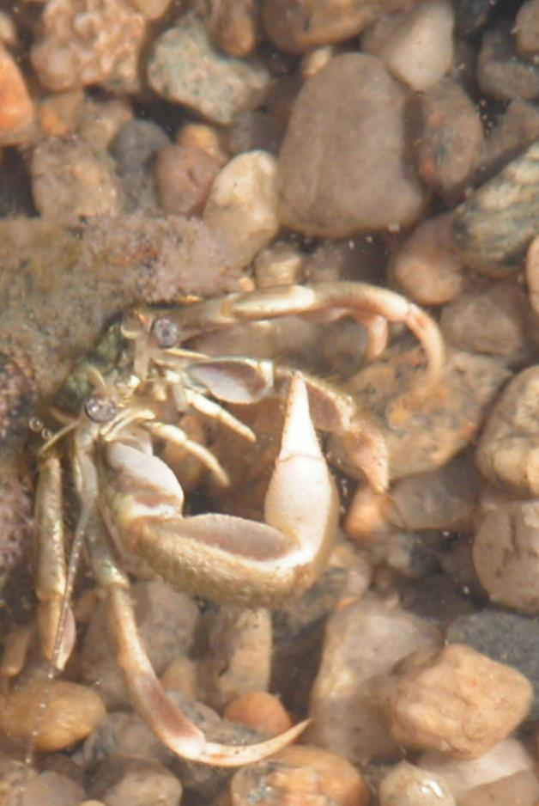
The longwrist hermit crab, carrying an empty snail shell on its back for protection, moves about in the shallows of the marsh and tidal flats As it outgrows its shell, it needs to find a new, larger one
Photo: Longwrist hermit crab, Pagurus longicarpus; courtesy of Nancy Balcom
Notes:
In order to grow, all crustaceans (crabs), including the longwrist hermit crab, must periodically molt or shed their exoskeletons, the hard shell parts covering their legs and carapace (body). Underneath the hard shell is a softer, larger exoskeleton, which can take days to harden fully. (Soft-shell blue crabs, a popular food item in the Chesapeake Bay region, are crabs that have molted but their new shells have not yet hardened.)
Molting occurs more often during the early life stages of a crustacean, but is less frequent as the animal gets older, following the growth rate pattern of the animal.
While most crabs have a complete hard exoskeleton covering their bodies, a hermit crab must find a new, larger, vacant snail shell to carry on its back each time it molts, in which to tuck and protect its soft abdomen and tail.
Photo: Longwrist hermit crab, Pagurus longicarpus; courtesy of Nancy Balcom

Slide 18
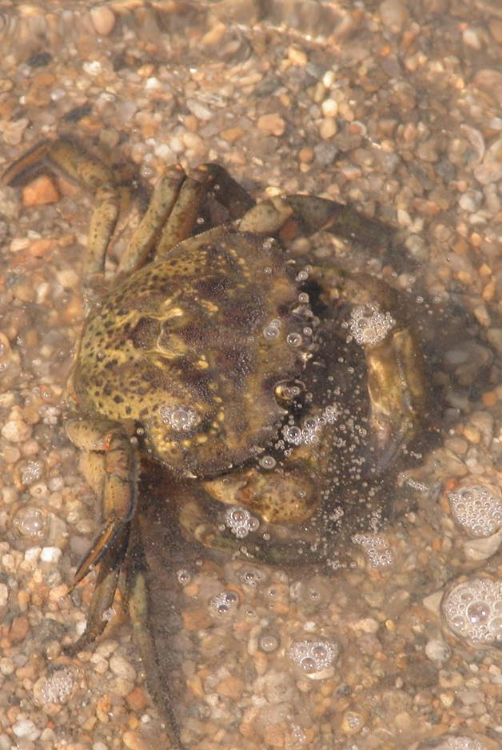
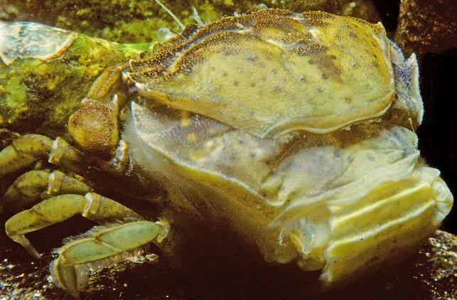
Green crabs inhabit the Sound’s marshes, rocky areas and tidal flats; voracious eaters of bivalve shellfish, they also eat seaweed and worms and other crabs
Photos: (left) molting green crab, Carcinus maenas; courtesy of Robert Bachand; (right) courtesy of Nancy Balcom
Notes:
The green crab is an omnivore, meaning it eats both plants and animals. Favorite foods include seaweeds and young oysters and clams.
The green crab is not endemic (native) to Long Island Sound. It was introduced more than 150 years ago, probably hitching rides over on or in wooden ships from Europe. Its voracious eating habits have been blamed for adversely impacting the soft-shell clam industry in parts of New England.
Once very common in the Sound, the green crab is dramatically outnumbered in the rocky intertidal areas by a more recent non-native invader, the Asian shore crab, Hemigrapsus sanguineus).
When any crustacean molts, the back edge of its carapace or shell splits and the soft-bodied crab backs out of its old shell. The new shell expands with water to a larger size and hardens in a few days – this is a vulnerable time for crustaceans.
Photos: (left) molting green crab, Carcinus maenas; courtesy of Robert Bachand; (right) courtesy of Nancy Balcom

Slide 19
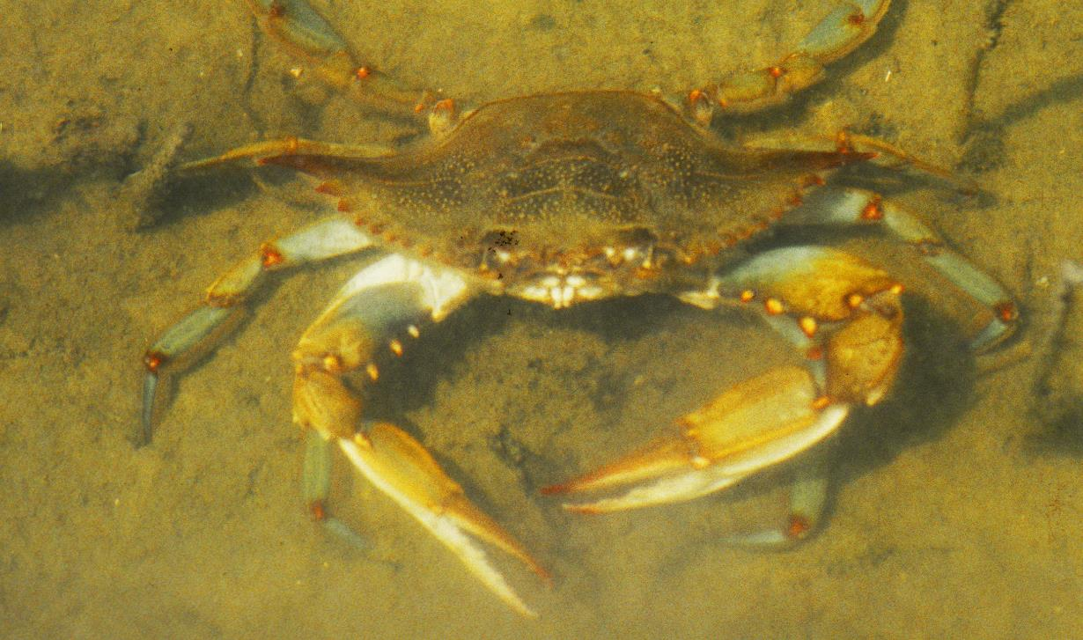
Tidal creeks and mosquito ditches winding through the salt marsh shelter small fish from most larger predators, while blue crabs forage for prey in these creeks
Photo: Blue crab, Callinectes sapidus; courtesy of Robert Bachand
Notes:
Blue crabs, like lobsters, are popular people food. Their last pair of legs are paddle-shaped, adapted for swimming and digging. The males have bright blue claws and the females, red claws, with an olive to bluish green carapace that can measure as much as 9 inches from spine tip to spine tip.
Blue crabs are fast, voracious predators.
Photo: Blue crab, Callinectes sapidus; courtesy of Robert Bachand

Slide 20
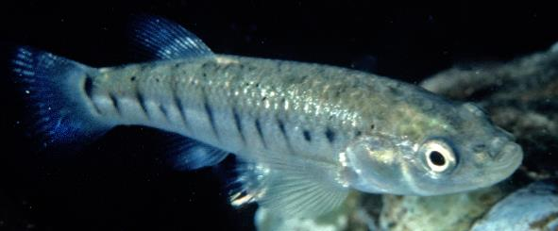
Striped killifish and other minnows rely on camouflage coloration and swimming in schools to confuse their predators
Photo: Striped killifish, Fundulus majalis; courtesy of Nancy Balcom; (inset) courtesy of Robert Bachand
Notes:
How many can you see? These minnows have silvery sides and black vertical or horizontal stripes, and are usually between 1 and 2.5” long
Photo: Striped killifish, Fundulus majalis; courtesy of Nancy Balcom; (inset) courtesy of Robert Bachand

Slide 21
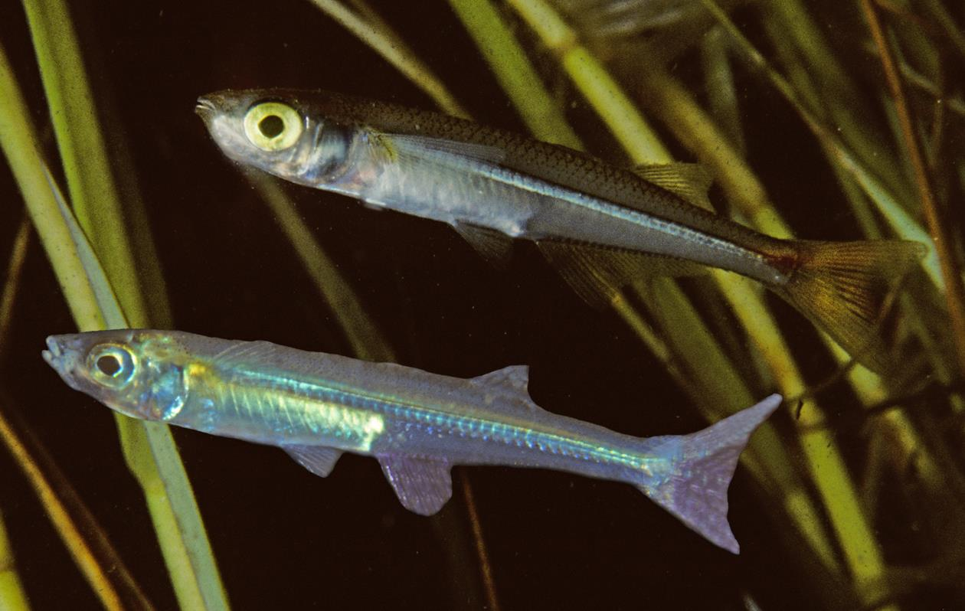
Atlantic silversides, named for the silvery metallic stripe along their bodies, are an important source of food for predators like striped bass and bluefish
Photo: Atlantic silversides, Menidia menidia, swimming among marsh grass; courtesy of Robert Bachand
Notes:
Photo: Atlantic silversides, Menidia menidia, swimming among marsh grass; courtesy of Robert Bachand

Slide 22
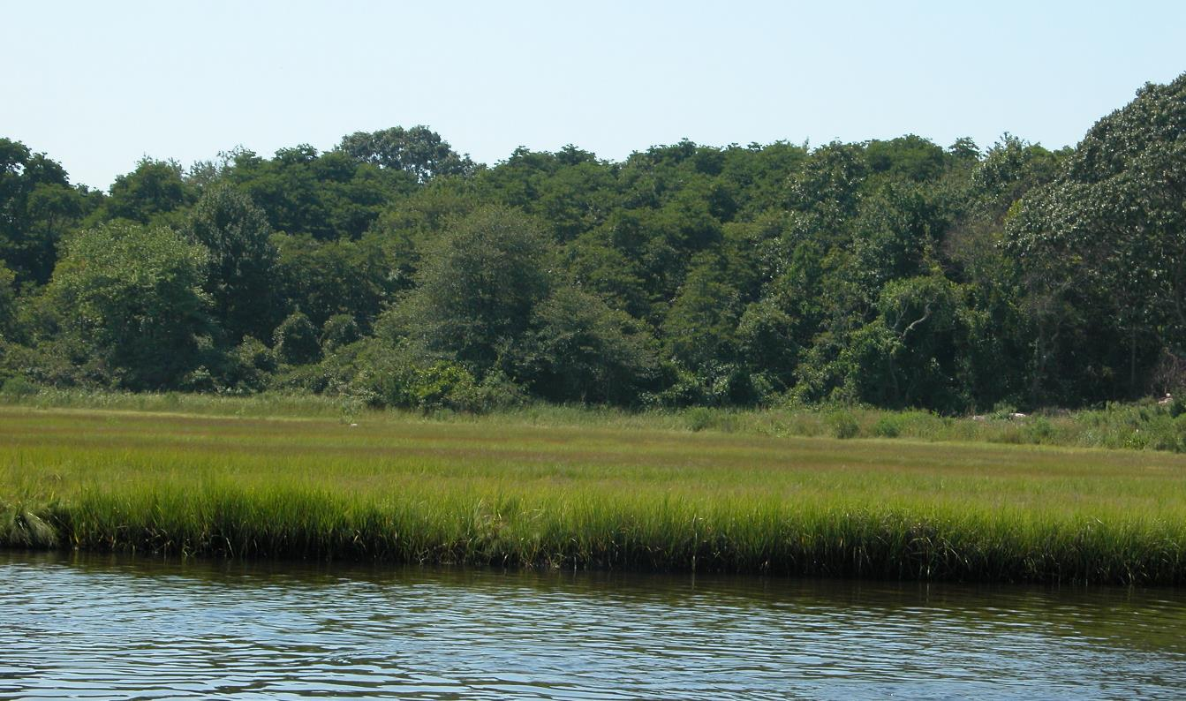
The uplands are a transition zone from marsh to forest, and are home to many shrubs and broad-leaved plants
Photo: upland marsh at Barn Island (Groton, CT); courtesy of Nancy Balcom
Notes:
Photo: upland marsh at Barn Island (Groton, CT); courtesy of Nancy Balcom

Slide 23
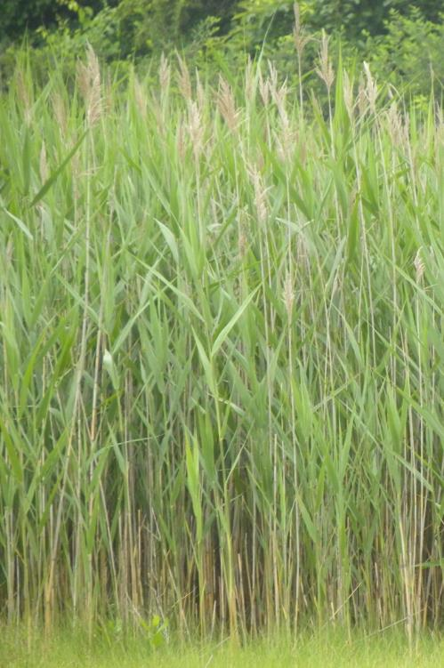
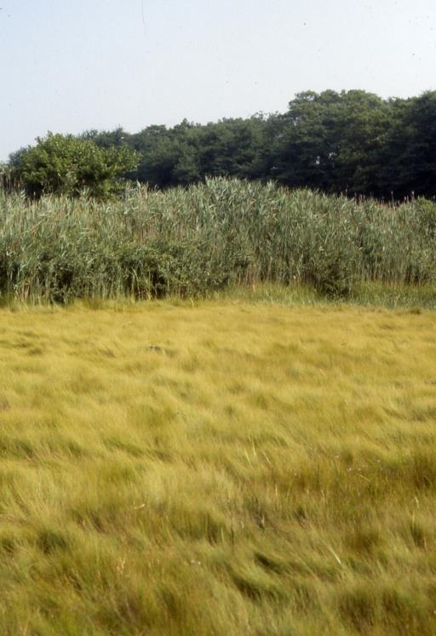
Common reed or Phragmites often grows in dense stands at the upland edge of disturbed marshes; the thick stems can reach 15 feet tall
Photos: Common reed, Phragmites australis; courtesy of Nancy Balcom
Notes:
Phragmites australis has both native and invasive strains; however it is the invasive strain that forms the dense, mono-culture stands of grass in freshwater, brackish or salt marsh areas. The plant is an opportunist, and often invades and dominates disturbed areas (look along the highways, for example)
One of the problems with Phragmites is that it grows so tall and so thickly that it takes over and prevents other native vegetation from growing in those same areas. Phragmites does not provide the same value of food and shelter resources that the displaced native plants do.
Photos: Common reed, Phragmites australis; courtesy of Nancy Balcom

Slide 24
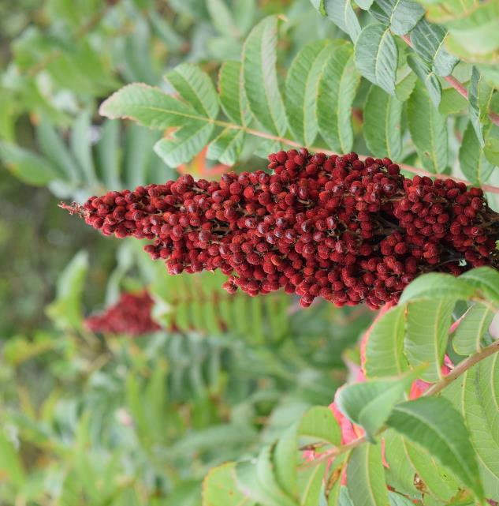
Sumac is a shrub that grows in the upland zone, providing food and shelter for birds
Photos: Shining sumac and seed head, Rhus copallinum; courtesy of Nancy Balcom
Notes:
There are several species of sumac. The ones with red berries do not cause skin irritation.
Photos: Shining sumac and seed head, Rhus copallinum; courtesy of Nancy Balcom

Slide 25
Two sparrow species of special concern, the seaside sparrow (left) and the saltmarsh sharp-tailed sparrow (right), rely on larger patches of salt marsh in Long Island Sound as key habitat; they build their nests in the marsh grasses
Photos: (left) Seaside sparrow, Ammodramus maritimus, and (right) Saltmarsh sharp-tailed sparrow, Ammodramus caudacutus; courtesy of Chris Elphick and Carina Gjerdrum
Notes:
These two species of salt marsh sparrow are listed among the highest avian conservation priorities in eastern North America; the saltmarsh sharp-tailed sparrow has also been given the internationally-recognized designation of “Globally-Vulnerable” species; the seaside sparrow is listed by both CT and NY as a species of “special concern” under state endangered species law – the saltmarsh sharp-tailed sparrow is also listed as a species of “special concern” by Connecticut
They seem to be “area-sensitive” meaning they are found in larger salt marshes but not in smaller patches; studies are ongoing to determine why
The seaside sparrow nests in the tall Spartina alterniflora that grows at the edge of the marsh and along the edges of the mosquito ditches, and is thus considered a “low marsh” species
The saltmarsh sharp-tailed sparrow builds its nest in the grasses of the high marsh; successful nesting is dependent on nest elevation and tight timing, as the eggs are laid and hatch in the short period between alternating spring high tides that flood the high marsh and the nests. If there is a lot of rain, the intervening tides can cause flooding too - when this happens nest failure is almost complete, as the birds don't have time to brood a new clutch of eggs.
Photos: (left) Seaside sparrow, Ammodramus maritimus, and (right) Saltmarsh sharp-tailed sparrow, Ammodramus caudacutus; courtesy of Chris Elphick and Carina Gjerdrum

Slide 26
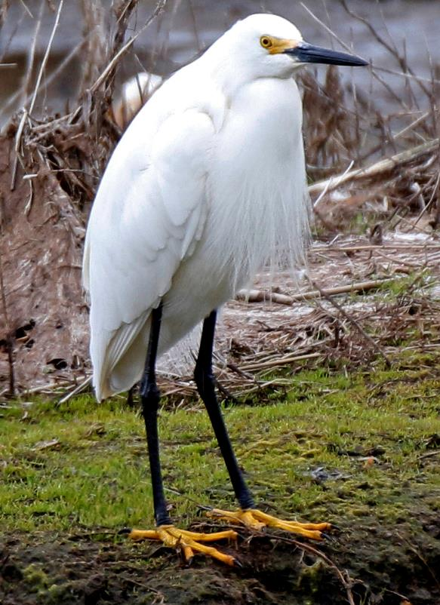
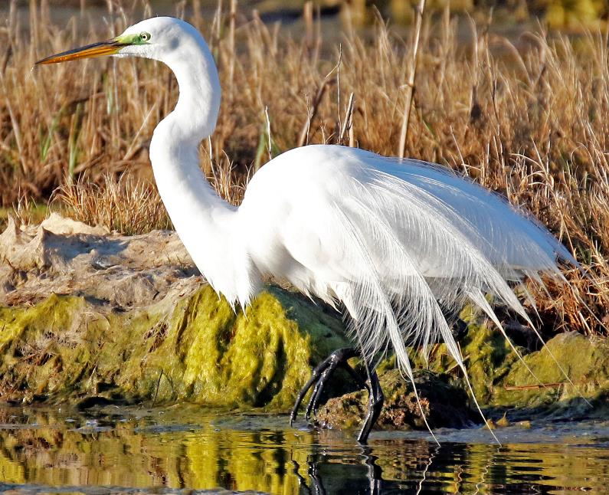
Great egrets (left) and snowy egrets (right) are commonly found wading in the shallows of salt marshes and tidal channels to spear fish; most are colonial nesters
Photos: Great Egret, Ardea alba (left) and Snowy Egret, Egretta thula; courtesy of Thomas Morris
Notes:
Great egrets have a yellow bill and black feet and are larger than snowy egrets, which have a black bill, black legs and yellow feet
Photos: Great Egret, Ardea alba (left) and Snowy Egret, Egretta thula; courtesy of Thomas Morris

Slide 27
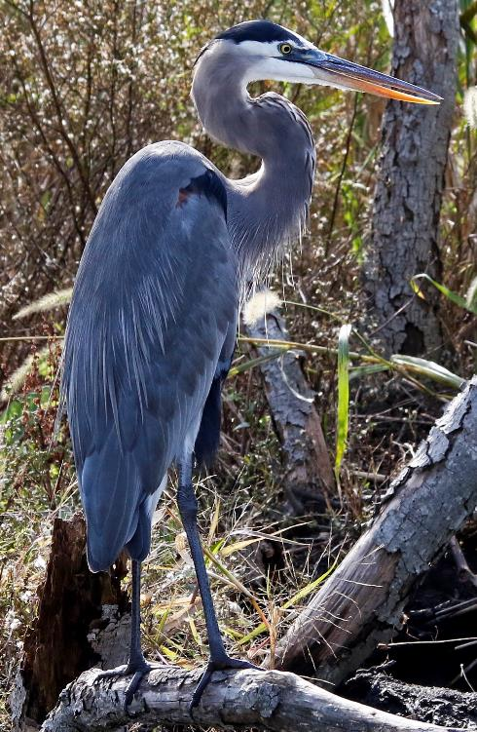
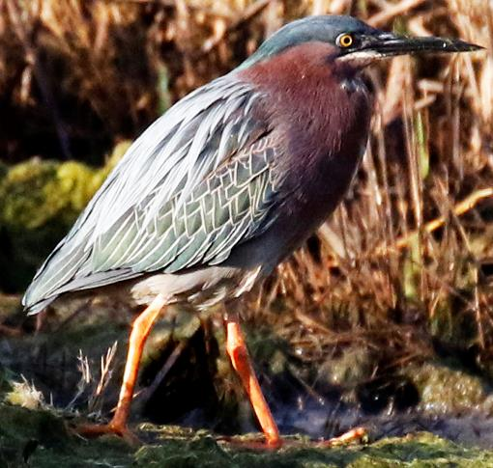
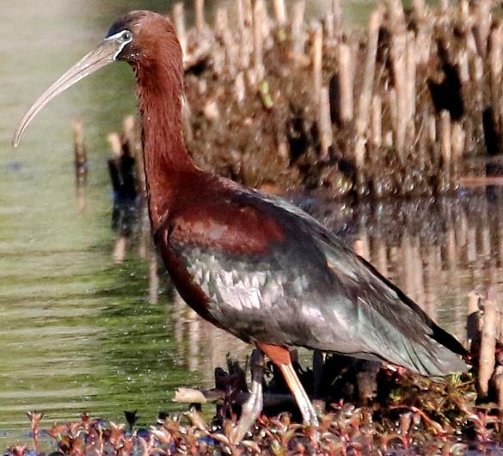
The great blue heron (left) and green heron (center) feed on fish while the glossy ibis (right) feeds on aquatic invertebrates
Photos: (left) Great Blue Heron, Ardea Herodias; (center) Green heron, Butorides virescens, and (right) Glossy Ibis, Plegadis falcinellus; courtesy of Thomas Morris
Notes:
Photos: (left) Great Blue Heron, Ardea Herodias; (center) Green heron, Butorides virescens, and (right) Glossy Ibis, Plegadis falcinellus; courtesy of Thomas Morris

Slide 28
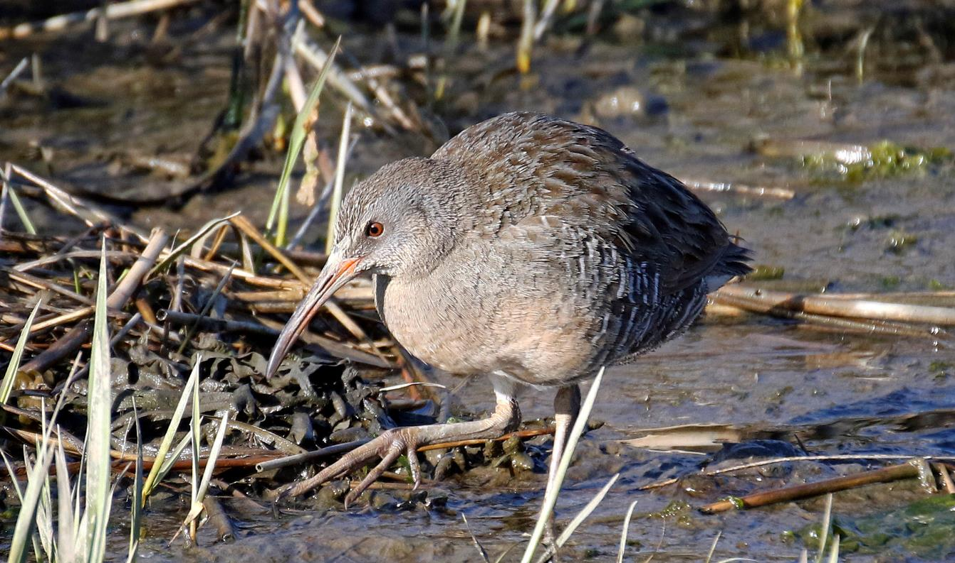
Clapper rails live in salt marshes; they use the marsh vegetation as refuges, especially at high tide; these birds feed on fiddler and other crabs, fish and plant matter
Photo: Clapper Rail, Rallus crepitans; courtesy of Thomas Morris
Notes:
Photo: Clapper Rail, Rallus crepitans; courtesy of Thomas Morris

Slide 29
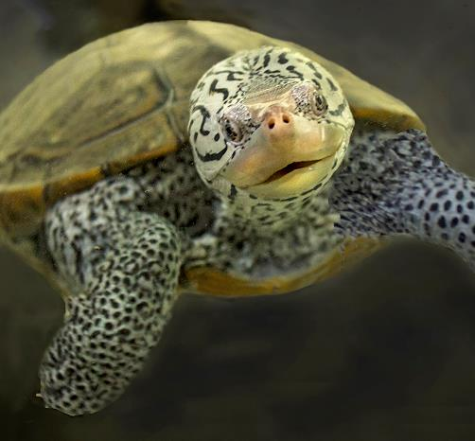
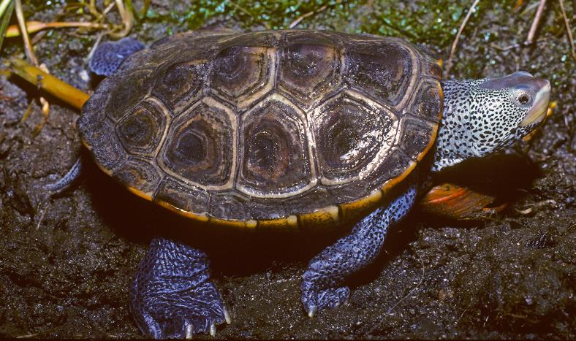
Diamondback terrapins live in the Sound’s salt marshes and tidal creeks, eating a mixture of fish, snails, crabs and worms; once hunted for their meat, they are now protected in both Connecticut and New York
Photos: Northern diamondback terrapins, Malaclemys t. terrapin; courtesy of Robert Bachand
Notes:
Only species of turtle in North America that spends its life in brackish water (a mix of fresh and salt water)
They overwinter by hibernating in tidal creek mud
Females weight up to 1.5 pounds (6-9 inches long) while males weigh about .5 pound (4-5.5 inches long)
Photos: Northern diamondback terrapins, Malaclemys t. terrapin; courtesy of Robert Bachand

Slide 30
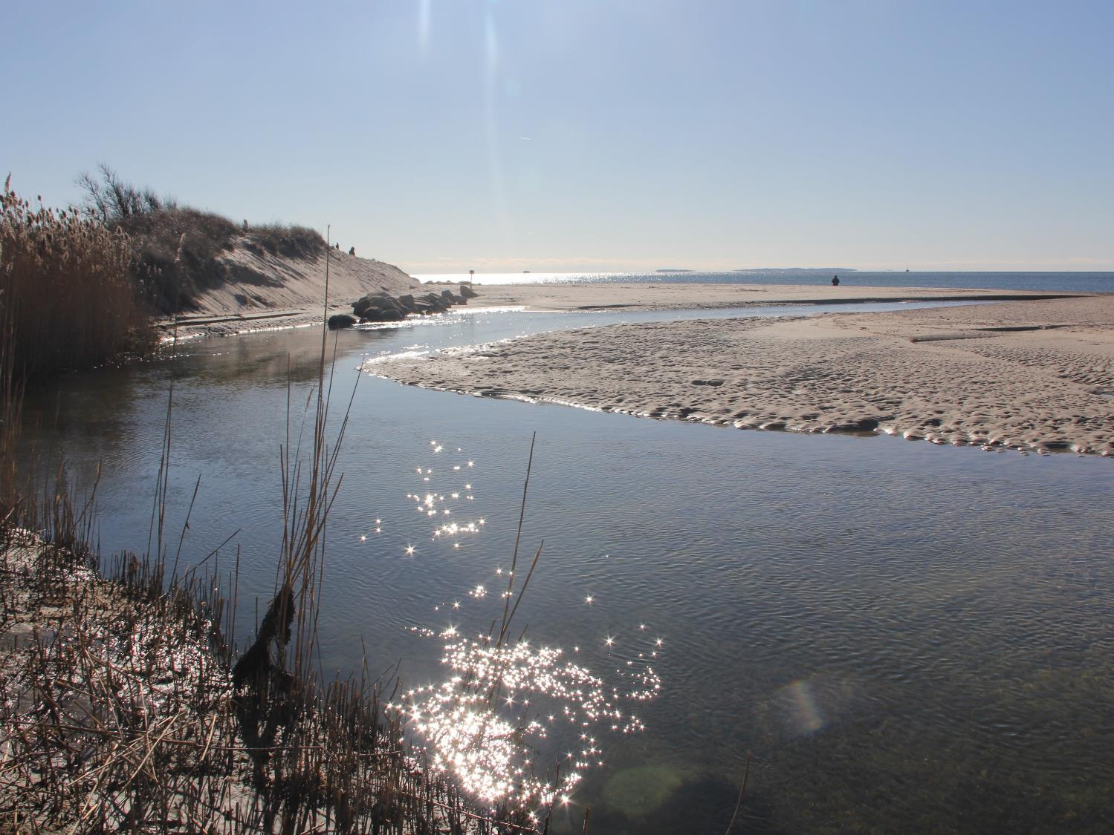
Tidal Flats: Low Energy Calm
Photo: Goshen Cove tidal flat; courtesy of Judy Benson
Notes:
Tidal flats are lower energy sandy or muddy areas in the estuary. They are intertidal, subject to daily periods of exposure to air followed by complete inundation by water
Tidal flats are often bordered by salt marshes, eelgrass beds, or deep channels
Flats support communities of snails, worms, burrowing clams, among others
Photo: Goshen Cove tidal flat; courtesy of Judy Benson

Slide 31
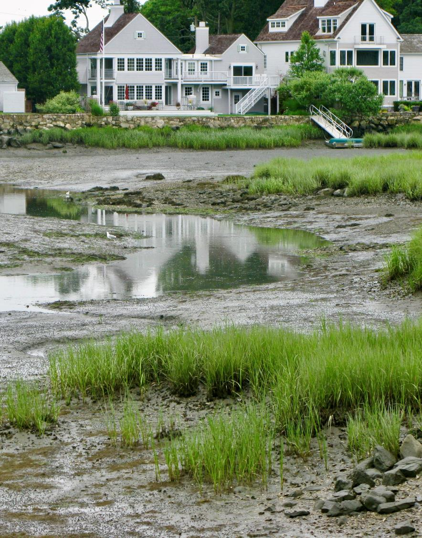
Water currents near tidal flats are quieter, allowing mud or sand to settle out; the fine sands, silts, and clay particles trap a lot of organic debris, which is then broken down by bacteria and fungi
Photo: Tidal flat; courtesy of Judy Preston
Notes:
Photo: Tidal flat; courtesy of Judy Preston

Slide 32
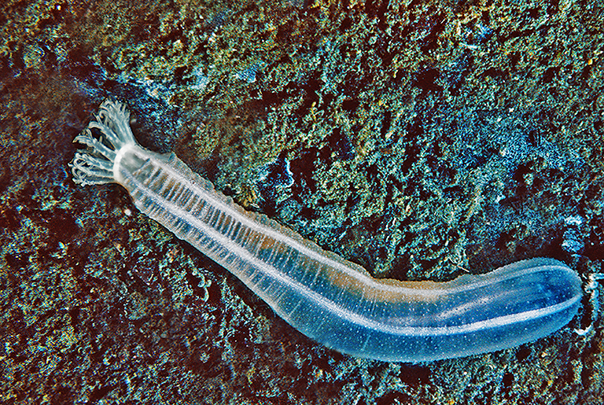
Photo: White synapta (sea cucumber), Leptosynapta tenuis; courtesy of Robert Bachand
This translucent white sea cucumber, reaching up to 6 inches (15 cm) in length, is very common; it burrows into mudflats, sandflats and gravel in the intertidal zone and in deep water
Notes:
Photo: White synapta (sea cucumber), Leptosynapta tenuis; courtesy of Robert Bachand

Slide 33
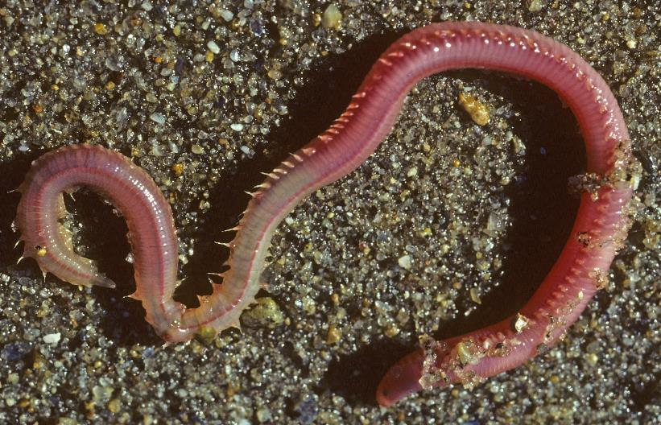
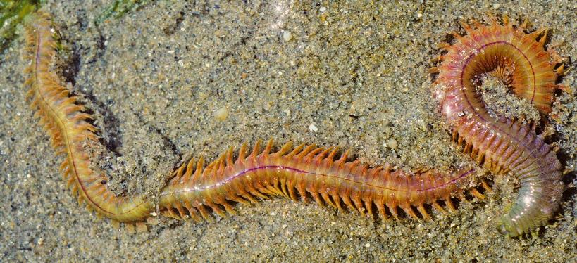
Segmented bristled worms work the sand and mud, helping to bring oxygen down into the sediment Food for other animals, bloodworms (top) and clam worms (bottom) are good fish bait, especially for winter flounder
Photo: (top) Bloodworm, Glycera dibranchiata; and (bottom) Clam worm, Nereis virens; courtesy of Robert Bachand
Notes:
Long Island Sound is also home to a variety of unsegmented round and flat worms.
Benthic infauna are organisms such as worms that live in the bottom sediments.
Photo: (top) Bloodworm, Glycera dibranchiata; and (bottom) Clam worm, Nereis virens; courtesy of Robert Bachand

Slide 34
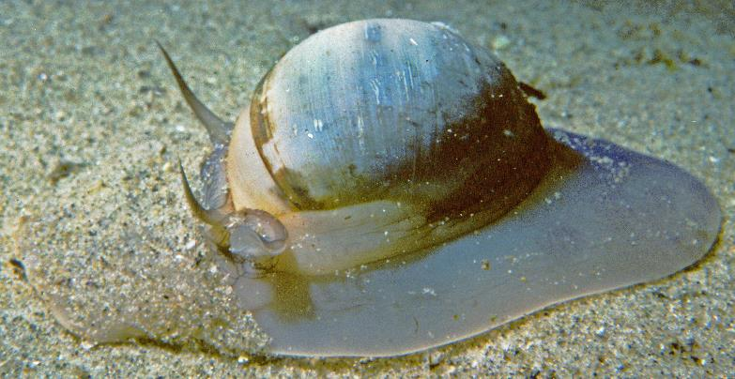
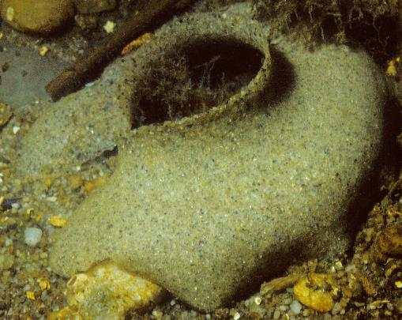
A moon snail is a gastropod mollusc that uses its file-like mouth part to drill holes in bivalve molluscs for food; it constructs gelatinous sand grain egg cases, which sometimes can be found on the beach resembling fragile sand “collars”
Photos: Northern moon snail, Euspira heros, and sand grain egg case; courtesy of Robert Bachand
Notes:
Gastropods are molluscs with one continuous shell or valve, including mud snails, periwinkles, moon snails, and whelks. Snails have one foot and can enclose their entire bodies within their shell.
They have an additional piece of shell on their foot, called an operculum, which acts as a door. When exposed to air, for example, the snail pulls itself completely inside and “shuts the door”, enabling the animal to keep its body moist until it is returned to the water. The shell also provides protection from predators.
Photos: Northern moon snail, Euspira heros, and sand grain egg case; courtesy of Robert Bachand

Slide 35
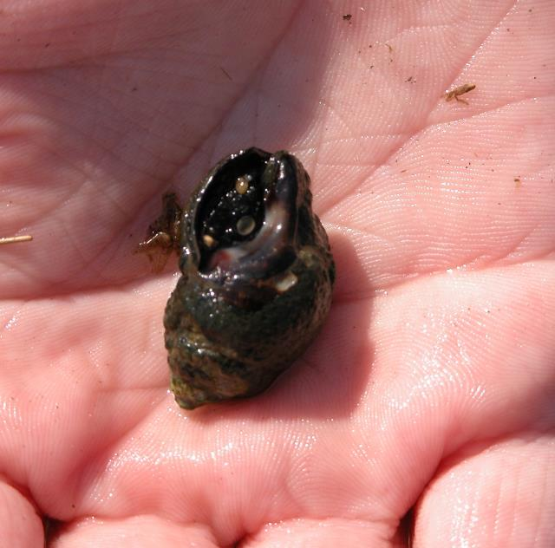
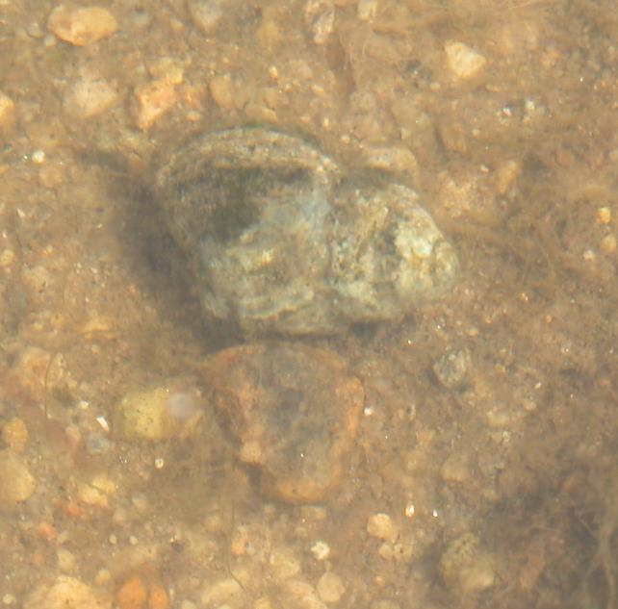
Mud snails feed on detritus (decaying material) and algae on the surface of tidal flats
Photos: Individual mud snails (left & right), Tritia obsoleta; courtesy of Nancy Balcom
Notes:
Mud snails feed on detritus (decaying material) and algae on the surface of tidal flats.
Photos: Individual mud snails (left & right), Tritia obsoleta; courtesy of Nancy Balcom

Slide 36
A hard clam feeds by drawing water in through one of its two siphons, straining plankton from the water, and discharging the water and its wastes through the other siphon
Photo: Hard clam, Mercenaria mercenaria; courtesy of Peter Auster/Robert DeGoursey
Notes:
Hard clams are bivalve molluscs, which means they have two shells that are hinged. Other bivalves include razor clams, oysters, soft-shell clams, and mussels.
The clam moves on its single foot, which is shaped like a tongue, pulling itself through the mud or sand.
Bivalve shellfish are filter feeders, drawing water in through one siphon, straining out the plankton, and discharging the water through a second siphon, along with the animal’s wastes.
Hard clams are an important shellfish industry in Long Island Sound. They are grown on the bottom of Long Island Sound by shellfish farmers, along with oysters. Underwater shellfish farms are among the largest farms in the region
Photo: Hard clam, Mercenaria mercenaria; courtesy of Peter Auster/Robert DeGoursey

Slide 37
Often, the only signs that bivalve molluscs are present in tidal flats are their siphons extending from holes in the sand or mud as they filter microscopic plankton from the water
Photo: clam siphons; courtesy of Tessa Getchis
Notes:
Photo: clam siphons; courtesy of Tessa Getchis

Slide 38
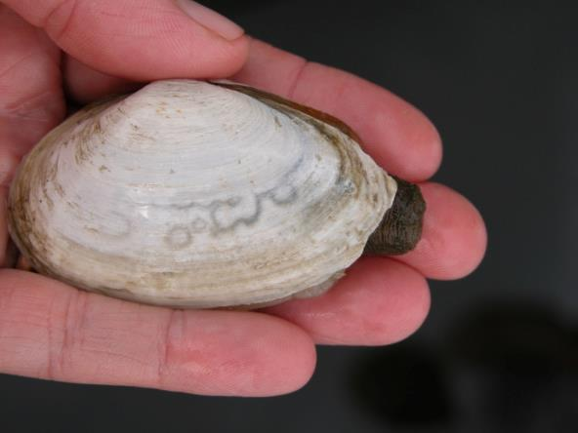
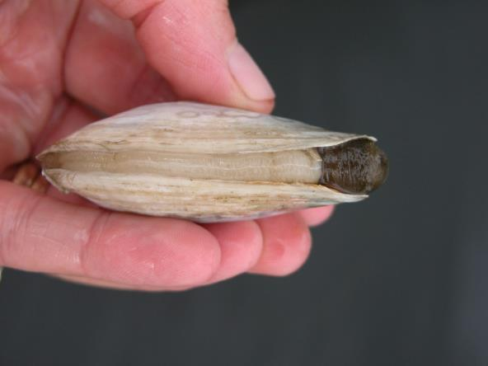
Softshell clams, also known as steamers or long-necks, live in deep burrows in the flats and shallows; when disturbed, they shoot up a spurt of water
Photos: Softshell clam, Mya arenaria; courtesy of Tessa Getchis
Notes:
Photos: Softshell clam, Mya arenaria; courtesy of Tessa Getchis

Slide 39
Razor clams burrow in the mud or sand straight up and down; they are fast and deep “diggers”
Photo: Razor Clams (juveniles), Ensis directus; Tessa Getchis
Notes:
With the exception of the Eastern oyster, all bivalve molluscs in Long Island Sound have a single foot, which they extend from their shells and use to pull themselves through the sand or mud
Photo: Razor Clams (juveniles), Ensis directus; Tessa Getchis

Slide 40
Small, translucent sand shrimp burrow in the soft bottom sediments and are important food for other animals
Photo: Sand shrimp or sevenspine bay shrimp, Crangon septemspinosa; courtesy of Peter Auster/Robert DeGoursey
Notes:
Photo: Sand shrimp or sevenspine bay shrimp, Crangon septemspinosa; courtesy of Peter Auster/Robert DeGoursey

Slide 41
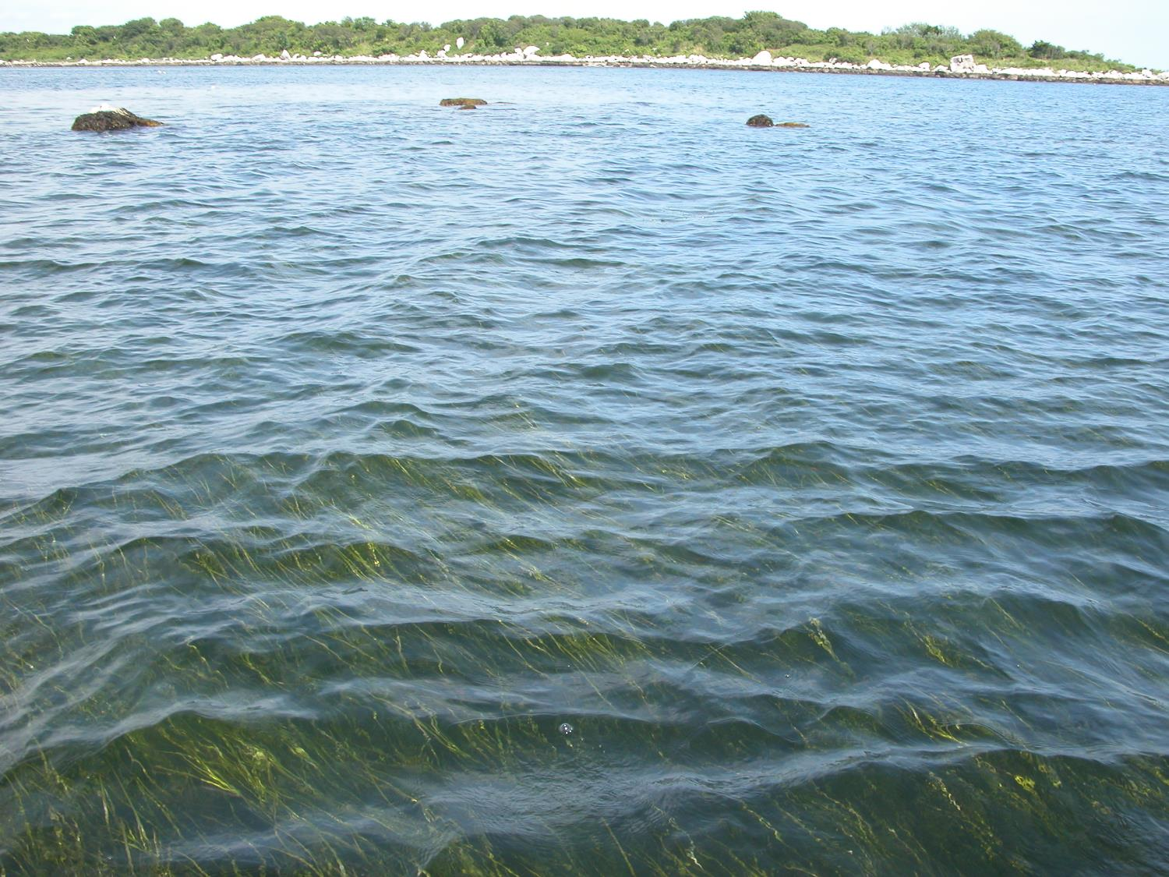
Eelgrass Beds: Sheltering Stabilizers
Photo: courtesy of Tessa Getchis
Notes:
Photo: courtesy of Tessa Getchis

Slide 42
Eelgrass grows in shallow waters where sunlight can reach deep enough to support the plant’s growth; the roots help stabilize soft bottom sediments from being eroded by tidal currents Many eelgrass beds in the Sound have disappeared due to disease, predation, or poor water quality
Photo: Eelgrass roots, Zostera marina; courtesy of Tessa Getchis
Notes:
Eelgrass and widgeon grass are the only completely submerged vascular plants (plants with true roots, stems, and seeds) occurring in Long Island Sound; they are sometimes referred to as submerged aquatic vegetation (SAV)
These plants stabilize soft sediments and are critical to many animals.
Photo: Eelgrass roots, Zostera marina; courtesy of Tessa Getchis

Slide 43
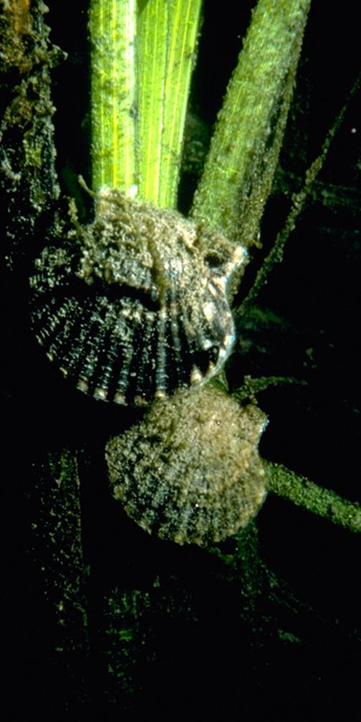
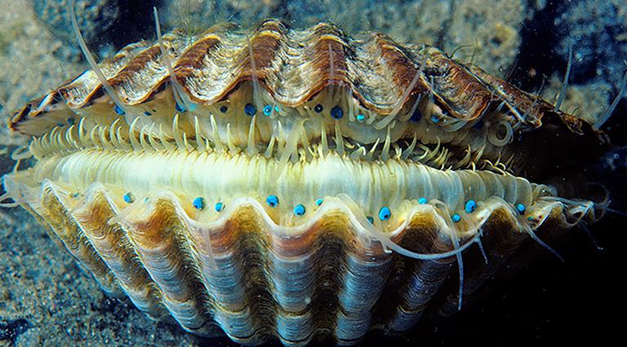
Eelgrass beds provide young fish and bay scallops with shelter from predators Juvenile bay scallops attach to the eelgrass blades during their first few weeks, which may help them avoid predation from crabs
Photos: (left) Juvenile bay scallops, Aequipecten irradians, on eelgrass blade, Zostera marina; courtesy of Peter Auster/Robert DeGoursey; (right) Bay scallop, Aequipecten irradians; courtesy of Robert Bachand
Notes:
Photos: (left) Juvenile bay scallops, Aequipecten irradians, on eelgrass blade, Zostera marina; courtesy of Peter Auster/Robert DeGoursey; (right) Bay scallop, Aequipecten irradians; courtesy of Robert Bachand

Slide 44
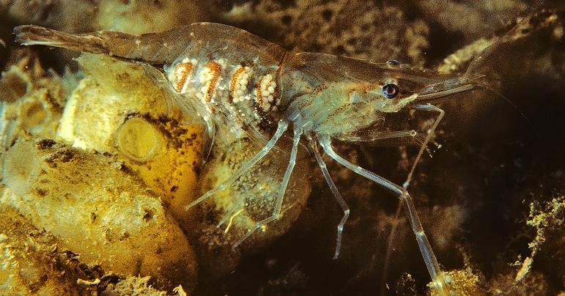
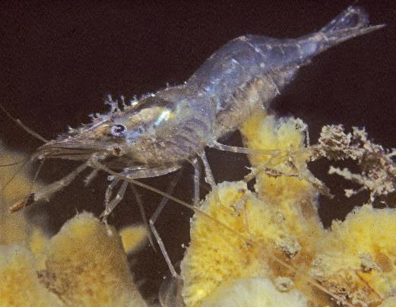
Translucent grass shrimp are common shallow-water inhabitants, finding shelter among aquatic vegetation such as eelgrass; they are preyed upon by many organisms
Photos: (left) Daggerblade shrimp carrying eggs, Palaemonetes pugio; (right) Grass shrimp, Palaemonetes vulgaris, courtesy of Robert Bachand
Notes:
Photos: (left) Daggerblade shrimp carrying eggs, Palaemonetes pugio; (right) Grass shrimp, Palaemonetes vulgaris, courtesy of Robert Bachand

Slide 45
Mute swans dine heavily on eelgrass and the green seaweed, sea lettuce; their long necks enable them to reach down and pull the eelgrass out by its roots, destroying the beds
Photo: Mute swan, Cygnus olor; courtesy of Tessa Getchis
Notes:
Many species of waterfowl feed directly on eelgrass, including the non-native mute swan, Canada geese, and brant (a close relative of Canada geese)
Mute swans were brought to Long Island, New York in 1912 from Europe, and are now extremely common
These swans are very strong, and territorial, protective of their nests and young; they can be distinguished from native swan species by their orange-yellow bill
Photo: Mute swan, Cygnus olor; courtesy of Tessa Getchis

Slide 46
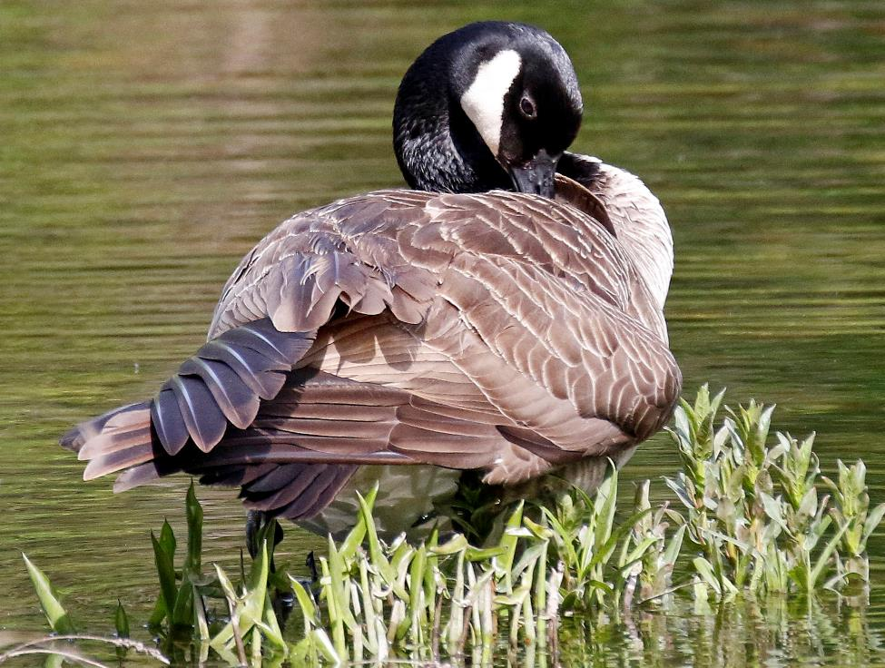
Canada geese also feed on aquatic vegetation and seaweed; they often concentrate in large flocks, and their wastes can cause local water quality problems
Photo: Canada goose, Branta canadensis; courtesy of Thomas Morris
Notes:
There are both resident and migratory populations of Canada geese around the Sound
In some places, these waterfowl have become so numerous that they are a nuisance. Canada geese graze on seaweeds, eelgrass, golf courses, and lawns
Males and females look alike.
Photo: Canada goose, Branta canadensis; courtesy of Thomas Morris

Slide 47
Sandy Beaches: Ever-Changing
Photo: Sandy beach at Hammonassett State Park, Madison, CT: courtesy of Judy Benson
Notes:
Photo: Sandy beach at Hammonassett State Park, Madison, CT: courtesy of Judy Benson

Slide 48
Sandy beaches are high-energy habitats that constantly change throughout the year, reflecting the effects of tides, winds, storms, and currents
Photo: Sandy beach, Fenwick, CT; courtesy of Nancy Balcom
Notes:
Waves and wind sort the grains of beach sand by size. Where waves are larger, mostly pebbles or shells may be deposited, whereas smaller waves will deposit sand, largely comprised of quartz. Note the reddish band - the red sand is garnet. Sometimes you may see a black band of sand, which is magnetite, which will cling to a magnet.
Photo: Sandy beach, Fenwick, CT; courtesy of Nancy Balcom

Slide 49
Red sand comprised of garnet (left) and slipper shells (right) deposited on sandy beaches by wind and waves
Photos: red sand and slipper shells on sandy beaches; courtesy of Nancy Balcom
Notes:
Atlantic slippersnails are hermaphroditic (they can change sex); they form stacks with females at the bottom, males at the top, and hermaphrodites in between
Photos: red sand and slipper shells on sandy beaches; courtesy of Nancy Balcom

Slide 50
Beach sands may appear devoid of life, but many tiny animals live beneath and between grains of sand, or in the wrack line, the line of decaying seaweed and eelgrass that washes up along the high tide mark
Photo: Wrack lines; courtesy of Nancy Balcom
Notes:
Photo: Wrack lines; courtesy of Nancy Balcom

Slide 51
Dune grass and plants help keep the sand in place; while the plants can withstand the harsh environment of a sandy beach, their root systems are fragile and easily damaged if walked on by humans
Photo: courtesy of Nancy Balcom
Notes:
Dune grass and other plants serve to anchor shifting sands in place and stabilize dune sands. Walking on these plants destroys their fragile root systems, and can result in dune loss or erosion from winter storm winds
Photo: courtesy of Nancy Balcom

Slide 52
The upper side of each beach grass blade has 10-12 parallel ridges, alternating with grooves, that run from the base to the tip; this ribbed structure causes the leaves to roll up tightly when water is scarce and to unroll when water is available
Photo: American beach grass, Ammophila breviligulata; courtesy of Nancy Balcom
Notes:
The plants that live on sandy beaches are adapted to withstand the harsh conditions created by sun, wind, tides, and storms.
Photo: American beach grass, Ammophila breviligulata; courtesy of Nancy Balcom

Slide 53
Beach pea grows on the dunes, helping to stabilize the sand while providing a splash of color throughout the summer; its dark brown seed pods (peas) are eaten by birds and mice
Photo: Beach pea plant and flower, Lathyrus japonicus; courtesy of Judy Preston
Notes:
True (vascular) plants, meaning those with internal plumbing systems to transport water and nutrients, are more common in fringing habitats of the Sound, such as the dunes
Like other plants in the legume family, the flowering beach pea is a nitrogen-fixer: nitrogen-fixers are plants whose roots are colonized by bacteria with the capability to extract nitrogen from the air and convert or “fix” it into a form they can use for growth. Later this nitrogen becomes available to the plant as well.
Beach peas primarily propagate by underground rhizomes (root system); they can be identified by their pink and purple flowers and coiling tendrils at the tips of the leaves
Photo: Beach pea plant and flower, Lathyrus japonicus; courtesy of Judy Preston

Slide 54
Rough cocklebur and northern seaside goldenrod are hardy plants that can call sandy or rocky beaches “home” - they help anchor beach sand in place
Photos: (left) Rough cocklebur, Xanthium echinatum; (right) Northern seaside goldenrod, Solidago sempervirens; courtesy of Nancy Balcom
Notes:
Seaside goldenrod also grows in the higher, drier, less saline parts of salt marshes
The prickly burs of the cocklebur are the fruits of this annual plant; each bur has two seeds inside. Based on difference in the seed coats, one seed will germinate the following year, the other one to two years later. The burrs also discourage predation.
Burs are easily transported as they readily attach to clothing or fur; this plant is not a strictly coastal species
Photos: (left) Rough cocklebur, Xanthium echinatum; (right) Northern seaside goldenrod, Solidago sempervirens; courtesy of Nancy Balcom

Slide 55
Other plants commonly found on sandy dunes and upper beaches are the American sea rocket (left) and saltwort (right); the seeds of the sea rocket float and are easily dispersed along the beach by water
Photos: (left) American searocket, Cakile edentula and (right) Saltwort, Salsola kali; courtesy of Nancy Balcom
Notes:
Photos: (left) American searocket, Cakile edentula and (right) Saltwort, Salsola kali; courtesy of Nancy Balcom

Slide 56
Salt-spray rose, with its pink or white flowers and prickly stems, is common to the upper reaches of the beach; high in Vitamin C, the colorful fruit or rose hips can be used in tea or jelly
Photo: Salt-spray rose, Rosa rugosa, and rose hips; courtesy of Nancy Balcom
Notes:
Although commonly found along the shore, salt-spray rose is not native to this region and is considered an invasive plant. A native of Asia, it was introduced to American rose growers from Japan in 1872.
Photo: Salt-spray rose, Rosa rugosa, and rose hips; courtesy of Nancy Balcom

Slide 57
Bayberry bushes, with their waxy blue berries and sweet-smelling leaves, grow in the sandy soil of the upper beach among the dune grasses
Photo: Bayberry, Morella pensylvanica; courtesy of Nancy Balcom
Notes:
Bayberry, a semi-evergreen shrub, is also found in the upland transition zone of salt marshes
Photo: Bayberry, Morella pensylvanica; courtesy of Nancy Balcom

Slide 58
The carnivorous channeled whelk (left) is one of the largest snails inhabiting the Sound; each disk of its parchment egg case (right) contains several fully formed baby whelks Retracting its soft body into the shell, the snail uses the smaller dark oval-shaped shell or operculum (arrow) to protect itself from predators and to retain moisture
Photos: (left) channeled whelk, Busycotypus canaliculatus, courtesy of Tessa Getchis; (right) channeled whelk egg case, courtesy of Robert Bachand
Notes:
The channeled and knobbed whelks are the largest snail species living in Long Island Sound (gastropod molluscs).
As carnivores, they use their large foot to hold a bivalve such as a hard clam and wedge the long edge of their shell in between the clam’s two shells.
The parchment egg cases of whelks are familiar to beachcombers. Each quarter-sized disk contains a number of miniature whelks. The tiny hole bored in the edge of each disk indicate the juvenile snails have left the disks.
A small piece of shell, called an operculum (arrow), is attached to the snail’s foot. When the snail body is drawn into the shell completely, the operculum serves as a door, protecting the tissues from predators and keeping the body moist
Photos: (left) channeled whelk, Busycotypus canaliculatus, courtesy of Tessa Getchis; (right) channeled whelk egg case, courtesy of Robert Bachand

Slide 59
Horseshoe crabs are one of the most primitive arthropods; they have lived unchanged in form for more than 360 million years Although they are arthropods, they are not true crabs, being more closely related to spiders and scorpions than they are to blue crabs and rock crabs
Photo: Horseshoe crab, Limulus polyphemus; courtesy of Robert Bachand
Notes:
Horseshoe crabs must molt to grow – look at the rounded front rim of a dead horseshoe crab on the beach to determine if it is a “molt” rather than a dead animal: if the rim is split, then it is a molted shell
A horseshoe crab’s tail is called a telson; the tail is used to flip the animal over if a wave flips it on its back; the tail has no stinger and is not used in defense
Horseshoe crabs have two primitive compound eyes
The mouth parts of a horseshoe crab are found on the underside in the middle of its five pairs of legs; the bristles on the legs act as “teeth”
The first pair of walking legs indicate the horseshoe crab’s gender; if there is a hook-like claw on the first pair, it is a male
During spring tides in late spring and early summer, horseshoe crabs come ashore to the beach in large numbers to mate and deposit their eggs; the eggs are ready to hatch when the next spring tide occurs about two weeks later, and the baby horseshoe crabs are washed into the water
This picture shows two smaller males hooked onto a large female using their specialized front claws; the males fertilize the eggs as they are laid in a nest in the sand
Photo: Horseshoe crab, Limulus polyphemus; courtesy of Robert Bachand

Slide 60
The front appendages of the burrowing mantis shrimp are similar to those of the praying mantis insect; barbs on these legs are used to quickly spear and crush prey
Photo: Mantis shrimp, Squilla empusa; courtesy of Robert Bachand
Notes:
Mantis shrimp stab with the spines at the end of their tail by quickly flipping their tail forward under their bodies
They can grow to 7.5” long and are more common in western Long Island Sound
Photo: Mantis shrimp, Squilla empusa; courtesy of Robert Bachand

Slide 61
Sanderlings (above) and piping plovers (right) skitter up and down the beach at the water’s edge, seeking small molluscs and crustaceans as the waves wash in and out
Photos: (top) Sanderlings, Calidris alba, and (right) Piping plover, Charadrius melodus; courtesy of Thomas Morris
Notes:
Piping plovers are the color of dry sand, enabling them to blend in and camouflage themselves when moving on the beach or sitting on their nests, built in shallow depressions in the sand, often lined with shells. The single dark band around their necks is visible only during the breeding season.
Plovers arrive to the Long Island Sound region to nest in late March. Three to four eggs are laid by late April, and the eggs take almost a month to incubate and hatch. They are considered a “threatened” species in Connecticut, “endangered” in New York, and “threatened” federally, due to increased shoreline development, human disturbances and increased predation. Their nests are often fenced off on beaches, along with those of the least tern, to protect them.
Plovers have defined beachfront territory. When something comes too close to a nest, the adults will try to distract it by flapping around like a wounded bird, sometimes called the “broken wing” display.
Sanderlings run back and forth on the beach, picking or probing for tiny prey in the wet sand. They are medium-sized sandpipers recognizable by their pale nonbreeding plumage, black legs and bill, and wave-chasing behavior. They breed only on High Arctic tundra, but during the winter they migrate long distances to sandy beaches worldwide.
Photos: (top) Sanderlings, Calidris alba, and (right) Piping plover, Charadrius melodus; courtesy of Thomas Morris

Slide 62
A black-bellied plover forages for worms, crustaceans or molluscs in wet sand; plovers have a distinctive behavior of running forward, pausing, looking or listening, then seizing their prey
Photo: Black-bellied plover, Pluvialis squatarola; courtesy of Thomas Morris
Notes:
Photo: Black-bellied plover, Pluvialis squatarola; courtesy of Thomas Morris

Slide 63
American oystercatchers, recognized by their bright red bills, prefer sandy shelly beaches without predators for nesting
Photo: American Oystercatchers, Haematopus palliates; courtesy of Thomas Morris
Notes:
Photo: American Oystercatchers, Haematopus palliates; courtesy of Thomas Morris

Slide 64
Common terns nest on rocky islands and barrier beaches, diving into open water for sand lances and other small fish, crustaceans and insects; they nest in colonies on sand, gravel or cobble near low-growing vegetation which provides cover for their chicks
Photos: Common tern adult and chick, Sterna hirundo – Great Gull Island , NY; courtesy of Nancy Balcom
Notes:
Common terns are small, gull-like birds with long, pointed wings and a forked tail, black cap, black tipped red bill and red legs.
Breeding pairs nest in small depressions on the ground to which they add dead vegetation, shell fragments, bones and stones. They lay 1-4 eggs per clutch and brood 1-2 times per year.
They aggressively defend their territory from intruders through posturing first, then wrestling and fencing with their bills. Humans entering nesting areas will be dived bombed by adults, pecked and defecated on.
Photos: Common tern adult and chick, Sterna hirundo – Great Gull Island , NY; courtesy of Nancy Balcom

Slide 65
Rocky Intertidal: High Energy Action
Photo: Rocky intertidal zone, Hammonassett Beach State Park, Madison CT; courtesy of Judy Benson
Notes:
The intertidal zone is the area between the reaches of the high and low tides – probably the harshest of the Sound’s habitats
Being able to “hang on” despite the intense wave action is an important characteristic of many organisms that live in the high energy, rocky intertidal zone. Barnacles cement themselves to the rocks, blue mussels attach to the rocks with amazingly strong threads (byssus), snails use suction to hang on, and seaweeds attach to the rocks with holdfasts.
Organisms living in the intertidal zone must also survive exposure to drying air during low tide, extreme heat during the summer and freezing temperatures in the winter, rainfall and freshwater runoff, and predation by terrestrial and aquatic organisms
There is intense competition for space in the intertidal zone
Photo: Rocky intertidal zone, Hammonassett Beach State Park, Madison CT; courtesy of Judy Benson

Slide 66
Intense wave action among the rocks, exposure to drying air during daily low tides, freezing winter and extreme summer temperatures, freshwater rainfall and predation create harsh conditions for organisms living in the rocky intertidal zone
Photo: (left) Rocky intertidal zone; courtesy of Nancy Balcom; (right) courtesy of Judy Benson
Notes:
Photo: (left) Rocky intertidal zone; courtesy of Nancy Balcom; (right) courtesy of Judy Benson

Slide 67
Zonation is evident in the rocky intertidal zone - lighter bands of barnacles higher on the rocks give way to darker bands of periwinkle snails, blue mussels, and various seaweeds lower on the rocks
Photo: Zonation patterns in rocky intertidal zone; courtesy of Nancy Balcom
Notes:
The upper intertidal zone is nearly terrestrial and is affected primarily by splash and spring tides
The middle intertidal zone is inundated twice daily by the tides and is home to barnacles, macroalgae (seaweeds), and mollusks such as periwinkle snails, slipper shells, and blue mussels competing with each other for surface space
The lower intertidal zone is nearly always inundated and abounds with rockweed and other macroalgae, sea stars and other spiny-skinned echinoderms, like sea urchins, and cnidarians like sea anemones
Macroalgae also grow subtidally
Photo: Zonation patterns in rocky intertidal zone; courtesy of Nancy Balcom

Slide 68
Rockweeds are brown seaweeds that inhabit the rocky intertidal zone, attaching to the rocks and providing food and shelter for many organisms
The “bladders” of rockweed serve to keep the seaweed near the surface and sunlight for photosynthesis
Photo: Knotted wrack, Ascophyllum nodosum; courtesy of Nancy Balcom
Notes:
Seaweeds, or marine macroalgae, provide habitat, food, and shelter for a number of aquatic organisms; there are more than 200 species in Long Island Sound
This particular species of seaweed is often used in Maine as packing material for live marine worms sold by bait dealers; other organisms may be living in the seaweed and therefore, fishermen should dispose of this packing material in the trash rather than dumping it into the Sound, to avoid introducing new species
Alginate from rockweed and brown kelp is used in syrups and as coatings for paper, film, medications, and fabric
Photo: Knotted wrack, Ascophyllum nodosum; courtesy of Nancy Balcom

Slide 69
Green sea lettuce grows abundantly in nutrient-rich waters, and is grazed upon by snails, crabs, some fish, and waterfowl
Photo: Sea lettuce, Ulva lactuca; courtesy of Nancy Balcom
Notes:
Sea lettuce is a source of food for mute swans, diving ducks and other waterfowl
Photo: Sea lettuce, Ulva lactuca; courtesy of Nancy Balcom

Slide 70
Deadman’s fingers, or green fleece, is a spongy, thick green alga (seaweed) that grows in the subtidal zone
Photo: (left) Deadman’s fingers, Codium fragile; courtesy of Tessa Getchis; Deadman’s fingers and holdfast; courtesy of Nancy Balcom
Notes:
Marine algae, or seaweeds, are classified as brown, green, or red algae based on structure, reproductive methods, and pigments (coloration)
These pigments absorb various frequencies of light, and the limited light available in coastal waters determines the depth to which the algae can grow
Green algae, such as deadman’s fingers or sea lettuce, have the same pigments as higher plants and are typically found closest to shore
Brown algae vary in color from olive brown to yellow brown; the brown pigments mask the green pigments; they are found generally in the shallows to mid-depths
Red algae also have green pigments that are masked by red pigments; these algae tend to be smaller and more delicate than the brown algae; they typically grow the deepest and farthest from shore
Deadman’s fingers is a non-native invasive algae, sometimes referred to as the “oyster thief” or “scallop thief” because when it attaches to a bivalve and grows, it sometimes becomes so buoyant that it lifts off the bottom and floats away with the bivalve
Photo: (left) Deadman’s fingers, Codium fragile; courtesy of Tessa Getchis; Deadman’s fingers and holdfast; courtesy of Nancy Balcom

Slide 71
Irish moss is a red alga that grows in dense clumps at the low tide line; it serves as food and habitat for many other species
Photo: Irish moss, Chondrus crispus; courtesy of Nancy Balcom
Notes:
Irish moss contains carrageenan, which is used to make many products such as pudding, ice cream, and toothpaste smooth and creamy
Photo: Irish moss, Chondrus crispus; courtesy of Nancy Balcom

Slide 72
Periwinkles are snails that live in huge numbers in the rocky intertidal area, scraping algae off the rocks with their radula (tongue-like organ)
Photos: Periwinkle, Littorina littorea; courtesy of Nancy Balcom
Notes:
The common periwinkle is a common sight in the rocky intertidal zone, along with its less common native cousins. This snail was introduced to North America more than 150 years ago by European settlers bringing familiar food sources with them from the Old World.
When the tide ebbs, periwinkles head for the underside of the rocks or seek shelter under the dark, moist rockweeds, to avoid drying out.
Photos: Periwinkle, Littorina littorea; courtesy of Nancy Balcom

Slide 73
Blue mussels grow in large clumps in the intertidal zone, attaching to the rocks and each other with strong, elastic threads called byssus or byssal threads
Photo: (Top) Blue mussels, Mytilus edulis, and (Inset) blue mussel byssal threads; courtesy of Nancy Balcom
Notes:
Photo: (Top) Blue mussels, Mytilus edulis, and (Inset) blue mussel byssal threads; courtesy of Nancy Balcom

Slide 74
Barnacles feed during high tide by waving feathery appendages through the water, sweeping plankton into their mouths; as the tide recedes, the valves at the top close tightly
Photo: Barnacles; courtesy of Nancy Balcom
Notes:
Barnacles are crustaceans with six overlapping plates, a base that is cemented to a hard surface, and two valves at the top; they “stand” on their heads inside and wave their feathery “feet” in the water column during high tide to bring food particles into their mouths
During low tide, they close up tight to remain moist
The feathery appendages are jointed and covered with an exoskeleton, like other crustaceans
Photo: Barnacles; courtesy of Nancy Balcom

Slide 75
The Asian shore crab is a species endemic to Japan and Asia; introduced to Long Island in the early 1990s, it is the most dominant crab in the intertidal zone, easily found between and under rocks at low tide
Photos: Asian shore crabs, Hemigrapsus sanguineus; courtesy of Nancy Balcom
Notes:
The Asian shore crab is easily distinguished by its striped legs, red spots on its claws, its boxier-shaped carapace that reaches ~1.5 inches in width; male crabs have a distinctive fleshy, bulb-like structure at the base of the moveable finger on the claws.
The green crab’s carapace is usually dark green, with yellowish or brown blotches; its carapace can be up to 3.5 inches wide; mature females have an orangey colored underside
Both crab species are omnivores, feeding on small shellfish such as mussels and oysters, other crabs, and seaweeds
Photos: Asian shore crabs, Hemigrapsus sanguineus; courtesy of Nancy Balcom

Slide 76
Several tunicate species or sea squirts inhabit the Sound; some are solitary organisms and others are colonial—made up of many individuals
Photos: Pacific rough sea squirt, Styela clava (left) and golden star tunicate, Botryllus schlosseri (middle); courtesy of Tessa Getchis; (right) close-up of golden star tunicate, Botryllus schlosseri; courtesy of Robert Bachand
Notes:
The Pacific rough sea squirt is brown or yellow with a rough, bumpy surface, up to 6” long
It is sometimes referred to as a biofouling organism, as it grows on lines, pilings, docks, and lobster pots
It is native to the Philippines and the South Pacific, arriving in New England in the late 1970s.
The golden star tunicate has yellow or white star shaped clusters on a dark brown, green, or purple background; commonly grows on eelgrass, pilings, and other solid substrates
Tunicates are an advanced class of invertebrates named after their outer covering or “tunic;” during their tadpole-like larval phase, they have a notochord (a precursor to our backbone), as well as a slender nerve chord and a primitive eye
Photos: Pacific rough sea squirt, Styela clava (left) and golden star tunicate, Botryllus schlosseri (middle); courtesy of Tessa Getchis; (right) close-up of golden star tunicate, Botryllus schlosseri ; courtesy of Robert Bachand

Slide 77
Clusters of sea grapes are commonly found on pilings, floats, and docks; solitary tunicates, they have two siphons used to filter water and food and excrete wastes
Photos: Sea grapes, Molgula spp.; courtesy of Tessa Getchis
Notes:
Photos: Sea grapes, Molgula spp.; courtesy of Tessa Getchis

Slide 78
Numerous gull species (‘seagulls”) live year-round or visit Long Island Sound, including the ring-billed gull (left) and herring gull (right) which nest in large colonies on islands from early May through July
Photo: (left) Ring-billed gull, Larus delawarensis; courtesy of Nancy Balcom; (right) Herring gull, Larus argentatus; courtesy of Thomas Morris
Notes:
A herring gull is gray and white with pink legs; a ring-billed gull is identified by its dark band around its yellow bill, with yellow legs, pale eye and gray back.
Both are omnivores, feeding on fish, insects, mussels, crabs, sea urchins, worms, small clams, and mussels; they are also avid garbage pickers, commonly found near dumps and landfills
Photo: (left) Ring-billed gull, Larus delawarensis; courtesy of Nancy Balcom; (right) Herring gull, Larus argentatus; courtesy of Thomas Morris

Slide 79
Double-crested cormorants live here year-round; they are more numerous in summer when they breed on rocky islands
Photos: (left and center) Doubled-crested cormorants, Phalacrocorax auratus; courtesy of Thomas Morris; (right) courtesy of Nancy Balcom
Notes:
Primitive fish-eating birds that are master divers and swimmers, they must occasionally dry their wings in the air because their feathers lack the oil that serves as a water repellent in other waterfowl
Photos: (left and center) Doubled-crested cormorants, Phalacrocorax auratus; courtesy of Thomas Morris; (right) courtesy of Nancy Balcom

Slide 80
Submerged Bottom: Mud to Boulders
Photo: courtesy of Ivar Babb and LISMaRC Science Team (UConn/U New Haven/USGS), Long Island Sound Study, CT-DEEP
Notes:
Photo: courtesy of Ivar Babb and LISMaRC Science Team (UConn/U New Haven/USGS), Long Island Sound Study, CT-DEEP

Slide 81
The seafloor in Long Island Sound is as diverse as the habitats along the shore, varying from mud and silt, to sand, to cobble and boulders
Photos: mud, sand, cobble; courtesy of Nancy Balcom
Notes:
Photos: mud, sand, cobble; courtesy of Nancy Balcom

Slide 82
Boulders, deposited by receding glaciers, provide structure and shelter for organisms living on or near the bottom of Long Island Sound
Photo: courtesy of Ivar Babb and LISMaRC Science Team (UConn/U New Haven/USGS), Long Island Sound Study, CT-DEEP
Notes:
Photo: courtesy of Ivar Babb and LISMaRC Science Team (UConn/U New Haven/USGS), Long Island Sound Study, CT-DEEP

Slide 83
Brown kelp, a seaweed, grows in subtidal beds or “forests,” attaching to hard surfaces on the bottom with a holdfast; kelp holdfasts and blades provide food and shelter for many benthic and pelagic species Kelp is farmed in Long Island Sound on longlines as a “sea vegetable”
Photos: Brown kelp, Laminaria saccharina, and farmed kelp; courtesy of Nancy Balcom
Notes:
Brown kelp is the largest and most structurally complex alga in Long Island Sound
Its cylindrical stipe (stem) contains alginate
Kelp is a new aquaculture or farmed marine product in Long Island Sound; it is used for human food, fertilizer and to help remove excess nutrients from the water, a process called bioextraction
Photos: Brown kelp, Laminaria saccharina, and farmed kelp; courtesy of Nancy Balcom

Slide 84
Photo: Breadcrumb sponges, Halichondria, pink tubularians, Tubularia indivisa, and pink-orange ghost anemones, Diadumene leucolena; courtesy of Ivar Babb and LISMaRC Science Team (UConn/U New Haven/USGS), Long Island Sound Study, CT-DEEP
Yellow breadcrumb sponges, pink tubularians and pink-orange ghost anemones feed by filtering plankton and particulates out of the water
Notes:
Photo: Breadcrumb sponges, Halichondria, pink tubularians, Tubularia indivisa, and pink-orange ghost anemones, Diadumene leucolena; courtesy of Ivar Babb and LISMaRC Science Team (UConn/U New Haven/USGS), Long Island Sound Study, CT-DEEP

Slide 85
Benthic rocky communities support attached organisms such as this frilled anemone, which, in turn, provide food and shelter for other organisms; anemones, with their stinging cells, are cnidarians
Photo: Frilled or clonal plumose anemone, Metridium senile; courtesy of Peter Auster / Robert DeGoursey
Notes:
Photo: Frilled or clonal plumose anemone, Metridium senile; courtesy of Peter Auster / Robert DeGoursey

Slide 86
Lined anemones attach to hard surfaces such as rocks, shells or pilings; the tentacles capture and direct food particles to the mouth in the center
Photo: Lined anemone, Fagesia lineata; courtesy of Robert Bachand
Notes:
Anemones, corals, hydroids, and jellyfish, soft-bodied animals equipped with stinging cells, all belong to the phylum Cnidaria. Stinging cells, or nematocysts, help stun and capture prey, which is then passed toward a central mouth.
Anemones are able to move about on their pedal disk (the rounded flat base of the stalk) in the manner of an inchworm; they extend their tentacles while feeding and can retract them into an inconspicuous disk
The white anemone can be translucent orange, pink, or white, and has 40-60 tentacles
Photo: Lined anemone, Fagesia lineata; courtesy of Robert Bachand

Slide 87
Corals are living colonies of individual cnidarians set within calcium carbonate shells; this northern star coral is found on rocky reefs in the Sound
Photos: Northern star coral, Astrangia poculata; courtesy of Robert Bachand
Notes:
Star corals are common on rocks below the low tide line to about 35 m (120 feet)
Photos: Northern star coral, Astrangia poculata; courtesy of Robert Bachand

Slide 88
Echinoderms are spiny-skinned animals with five-part symmetry, like sea stars and sea urchins Sea stars feed on shellfish, other invertebrates, and even fish, dead or alive
Photos: (left) Common sea star, Asterias forbesi; courtesy of Nancy Balcom; (right) Common sea star, Asterias forbesi; courtesy of Robert Bachand
Notes:
Sea stars have a rough exoskeleton with tiny white spines and five arms; they have some regenerative ability whereby if an arm is lost, it usually can be re-grown
The orange-red “spot” (called a madreporite) on the top works as a sieve plate through which water enters the internal water-vascular system of the animal
Running down the underside of each arm are 4 rows of tiny tube feet; internal water pressure enables the creation of suction in each of the tube feet, enabling them to extend, move, and “stick to” things, including the shells of a hard clam a sea star might be trying to eat
The mouth is found on the underside of the sea star, in the middle of the arms. When a sea star exerts enough force on the two shells of a hard clam to open them slightly, it will push its stomach into the shells and digest the soft tissues of the clam.
A light sensitive “eye” is located at the tip of each of the arms
Photos: (left) Common sea star, Asterias forbesi; courtesy of Nancy Balcom; (right) Common sea star, Asterias forbesi; courtesy of Robert Bachand

Slide 89
The blood star is another species of sea star that lives in Long Island Sound
Photo: Blood star, Henricia sanguinolenta; courtesy of Robert Bachand
Notes:
Photo: Blood star, Henricia sanguinolenta; courtesy of Robert Bachand

Slide 90
Sea urchins, armored with spines, have five hard pointed teeth at the center of their underside which they use to scrape algae and detritus off rocks and other substrates
Photos: (top) Green sea urchin, Strongylocentrotus droebachiensis, courtesy of Nancy Balcom; (bottom) Purple sea urchin, Arbacia punctulata; courtesy of Nancy Balcom; (bottom right) Sea urchins on LIS bottom courtesy of Ivar Babb and LISMaRC Science Team (UConn/U New Haven/USGS), Long Island Sound Study, CT-DEEP
Notes:
Sea urchins feed on algae such as kelp
Photos: (top) Green sea urchin, Strongylocentrotus droebachiensis, courtesy of Nancy Balcom; (bottom) Purple sea urchin, Arbacia punctulata; courtesy of Nancy Balcom; (bottom right) Sea urchins on LIS bottom courtesy of Ivar Babb and LISMaRC Science Team (UConn/U New Haven/USGS), Long Island Sound Study, CT-DEEP

Slide 91
Sea cucumbers are also echinoderms; the hairy or common sea cucumber lives on submerged bottom and feeds using ten finger-like tentacles around its mouth to filter plankton from the water column
Photos: (left) Hairy sea cucumber, Sclerodactyla briareus, actively feeding and (right) burrowing in Mystic Harbor mud bottom; courtesy of Robert Bachand
Notes:
With distinct front and rear ends, the hairy sea cucumber is dull brown and grows four to five inches long. Its fat, rounded body is covered with tube feet.
Photos: (left) Hairy sea cucumber, Sclerodactyla briareus, actively feeding and (right) burrowing in Mystic Harbor mud bottom; courtesy of Robert Bachand

Slide 92
Eastern oysters are an important commercial shellfish – bivalve molluscs They are farmed on the bottom of the Sound on leased grounds, a practice known as aquaculture
Photo: Eastern oyster, Crassostrea virginica; courtesy of Briarpatch Enterprises, Milford CT
Notes:
Molluscs include a wide variety of animals with a similar body plan. Most possess a body covering called a mantle which secretes a calcareous shell.
Single-shelled molluscs or gastropods, include snails and limpets
Two-shelled molluscs or bivalves, have hinged shells; they include blue mussels, clams, scallops, and oysters
Eastern oysters and hard clams comprise the majority of the Sound’s extensive commercial shellfish farms; shellfish are grown directly on the bottom on leased beds, or in cages or bags suspended above the bottom
Larval oysters require clean hard substrate, preferably old oyster shells called cultch, for attachment.
Juvenile oysters, or spat, can be collected from natural seed grounds and transferred to grow-out beds, or they can be raised in hatcheries and transplanted to grow-out grounds
Photo: Eastern oyster, Crassostrea virginica; courtesy of Briarpatch Enterprises, Milford CT

Slide 93
Nudibranchs are molluscs with no shells; they are sometimes referred to as “sea slugs” and can be very colorful
Photos: Red gilled Nudibranch, Flabellina verrucosathis (left) and Emerald elysia, Elysia chlorotica (right) – courtesy of Robert Bachand
Notes:
Photos: Red gilled Nudibranch, Flabellina verrucosathis (left) and Emerald elysia, Elysia chlorotica (right) – courtesy of Robert Bachand

Slide 94
The most commercially-important crustacean in Long Island Sound is the American lobster Crustaceans such as lobsters, shrimp and crabs, are arthropods; all arthropods have jointed appendages
Photo: American lobster, Homarus americanus; courtesy of Robert Bachand
Notes:
Muddy or soft substrates host a myriad of burrowing organisms (infauna) and organisms that are attached to or move slowly over the sediment surface, living on top of, rather than in, the sediments (epifauna).
Although they often burrow into the bottom muds for shelter, lobsters are considered neither epifauna nor infauna, because they are relatively mobile.
The American lobster population in Long Island Sound is greatly diminished form what it was in the 1990s. In 1999, the resource suffered a catastrophic die-off from which it hasn’t recovered. Warmer average water temperatures, due to a changing climate, have stressed this cold-water loving organism.
Photo: American lobster, Homarus americanus; courtesy of Robert Bachand

Slide 95
A lady crab is identified by its purple spots and sharp pincers Like the blue crab it is a swimming crab, using its back pair of paddle-shaped swimming legs to propel it through the water Red beard sponge offers a safe refuge
Photos: (top) Lady crab (Calico crab), Ovalipes ocellatus, and red beard sponge, Microciona prolifera; (bottom) swimming through the water; courtesy of Robert Bachand
Notes:
Photos: (top) Lady crab (Calico crab), Ovalipes ocellatus, and red beard sponge, Microciona prolifera; (bottom) swimming through the water; courtesy of Robert Bachand

Slide 96
Spider crabs are well camouflaged; primarily scavengers, they cluster together in groups to molt (shed their outer shell or exoskeleton in order to grow larger ) and mate
Photos: (left) Spider crab, Libinia sp.; courtesy of Ivar Babb and LISMaRC Science Team (UConn/U New Haven/USGS), Long Island Sound Study, CT-DEEP; and (right) Long-nosed spider crab, Libinia dubia; courtesy of Robert Bachand
Notes:
Photos: (left) Spider crab, Libinia sp.; courtesy of Ivar Babb and LISMaRC Science Team (UConn/U New Haven/USGS), Long Island Sound Study, CT-DEEP; and (right) Long-nosed spider crab, Libinia dubia; courtesy of Robert Bachand

Slide 97
Atlantic rock crabs are the favorite food of lobsters; they feed on worms, molluscs and other invertebrates
Photo: Atlantic rock crab, Cancer irroratus; courtesy of Robert Bachand
Notes:
Photo: Atlantic rock crab, Cancer irroratus; courtesy of Robert Bachand

Slide 98
Named for the translucent areas on either side of its “pointed snout”, a clearnose skate feeds along the bottom (benthos) of the Sound; relatives of sharks and rays, skates possess skeletons entirely made of cartilage
Photo: Clearnose skate, Raja eganteria; courtesy of Robert Bachand
Notes:
The diet of clearnose skates is primarily benthic invertebrates such as molluscs, shrimp, crabs and small fish
In 2017 a 9 lb 6 oz clearnose skate was caught by recreational angler Anthony Carpentino off New Haven – this fish established not only a new state record for Connecticut but also a new world record for this species
Photo: Clearnose skate, Raja eganteria; courtesy of Robert Bachand

Slide 99
Striped sea robins (left) and northern sea robins (right) migrate from deeper offshore waters to Long Island Sound in the spring to spawn and feed, returning to the deeper waters in the fall
Photos: (left) Striped sea robin, Prionotus evolans, and (right) northern sea robins, Prionotus carolinus; courtesy of Ivar Babb and LISMaRC Science Team (UConn/U New Haven/USGS), Long Island Sound Study, CT-DEEP
Notes:
Benthic organisms have numerous adaptations that suit them well to their existence. Many epifauna animals are able to lie quietly and blend in with the bottom.
Sea robins lie quietly on the bottom, blending in with their surroundings; the first 3 rays of the fish’s pectoral fins are separate, adapted to rout prey from the sediments
Photos: (left) Striped sea robin, Prionotus evolans, and (right) northern sea robins, Prionotus carolinus; courtesy of Ivar Babb and LISMaRC Science Team (UConn/U New Haven/USGS), Long Island Sound Study, CT-DEEP

Slide 100
Sea ravens and their relatives, sculpins, have large spiny heads and wide mouths; sea ravens possess fleshy tabs on their heads and ragged dorsal fins; they inhabit rocky or hard bottoms where they eat both invertebrates and finfish
Photo: Sea raven, Hemitripterus americanus; courtesy of Robert DeGoursey
Notes:
Photo: Sea raven, Hemitripterus americanus; courtesy of Robert DeGoursey

Slide 101
Winter flounder are year-round residents of Long Island Sound; “right-eyed” flatfish, they swim along the bottom feeding on soft-bodied animals in the sediments
Photo: Winter flounder, Pleuronectes americanus; courtesy of Robert Bachand
Notes:
Winter flounder move between inshore and offshore waters of the Sound on a seasonal basis – in winter and very early spring they move inshore to the shallows to spawn, and return to cooler, deeper waters of the Sound in the summer
A changing climate with warmer waters has made the Sound less hospitable to winter flounder who need cooler waters
When a winter flounder is very young, its left eye migrates to the right side of its head; this “right-eyed” flatfish spends the rest of its life swimming along the bottom on its right side, two eyes up
Photo: Winter flounder, Pleuronectes americanus; courtesy of Robert Bachand

Slide 102
Windowpane, or sand dabs, are also year-round flatfish residents of the Sound; “left-eyed” flatfish, they have larger mouths than winter flounder, and will leave the bottom to ingest swimming prey
Photo: Windowpane flounder, Scophthalmus aquosus; courtesy of Peter Auster Robert DeGoursey
Notes:
Windowpane are another species of flatfish, but are “left-eyed,” meaning they swim with their right side down, and their left side, with both eyes, up.
Photo: Windowpane flounder, Scophthalmus aquosus; courtesy of Peter Auster Robert DeGoursey

Slide 103
Like all flatfish, “left-eyed” summer flounder have a chameleon-like ability to change their color to blend in with the surrounding sediments, an adaptation that serves them well against most predators
Photo: Summer flounder, Paralichthys dentatus; courtesy of Robert Bachand
Notes:
Photo: Summer flounder, Paralichthys dentatus; courtesy of Robert Bachand

Slide 104
A black sea bass (left) and a scup or porgy (right) feed and shelter among the boulders; scup migrate to the Sound from their wintering grounds in Delaware Bay and Chesapeake Bay
Photo: (left) Black sea bass, Centropristis striata, and (right) scup, Stenotomus chrysops; courtesy of Ivar Babb and LISMaRC Science Team (UConn/U New Haven/USGS), Long Island Sound Study, CT-DEEP
Notes:
The colorful scup (porgies) feed on both invertebrates and small fish; they are popular with sport anglers for their vigorous fight on the line and are also harvested commercially
Photo: (left) Black sea bass, Centropristis striata, and (right) scup, Stenotomus chrysops; courtesy of Ivar Babb and LISMaRC Science Team (UConn/U New Haven/USGS), Long Island Sound Study, CT-DEEP

Slide 105
Cunner also like to hang around rocks and boulders; the warming climate has enabled this finfish species to expand its range north into Long Island Sound
Photo: Cunner, Tautogolabrus adspersus, courtesy of Robert Bachand
Notes:
Photo: Cunner, Tautogolabrus adspersus, courtesy of Robert Bachand

Slide 106
Open Water: Drifters and Swimmers
Photo: courtesy of Nancy Balcom
Notes:
Photo: courtesy of Nancy Balcom

Slide 107
The water column, or pelagic zone, of Long Island Sound is home to finfish and other interesting organisms, such as squid, jellyfish, and marine mammals
Photo: Open water; courtesy of Nancy Balcom
Notes:
Photo: Open water; courtesy of Nancy Balcom

Slide 108
Drifting microalgae or phytoplankton form the base of the food web in estuaries; here are a variety of microscopic marine diatoms common to Long Island Sound waters
Photo: Diatoms; courtesy of Connecticut Sea Grant
Notes:
Microscopic phytoplankton are usually free-floating single-cell algae; they also occur as multi-cellular colonial algae
Phytoplankton, such as diatoms, convert sunlight into living organic material through the process of photosynthesis, producing oxygen; they also serve as important food for herbivores
Diatoms have shells made of silica, and are sometimes referred to as “creatures in glass houses”
Too much of a good thing isn’t….scientists have determined that excess amounts of the nutrient, nitrogen, entering the Sound’s waters from sewage treatment plants and run-off from the land, lead to algae blooms in late summer in the western Sound; when the algae die, the decaying process consumes tremendous amounts of oxygen, causing oxygen levels to drop to levels that are dangerously low or lethal to other organisms living in the Sound
The Long Island Sound Study is addressing this problem by requiring many sewage treatment plants to implement tertiary treatment, which removes excess nutrients from the treated effluent prior to its discharge
Photo: Diatoms; courtesy of Connecticut Sea Grant

Slide 109
Zooplankton are drifting or weakly swimming organisms, ranging in size from this tiny (2-3mm) copepod to large jellyfish Most animals in the Sound, such as fish, crabs and clams, begin life as part of the zooplankton community
Photo: Copepod, Acartia hudsonica; courtesy of Amy N. Smith and Barbara Costas
Notes:
Copepods, amphipods, and other shrimp-like crustaceans spend their entire lives as zooplankton, while larval (immature) forms of barnacles, crabs, worms, mollusks, and finfish are temporary members of the zooplankton community
Photo: Copepod, Acartia hudsonica; courtesy of Amy N. Smith and Barbara Costas

Slide 110
A newborn longfin squid (top) and a larval American lobster (bottom) spend the early part of their life cycle among the zooplankton
Photos: (top) Longfin squid, Loligo pealeii; and (bottom) American lobster, Homarus americanus; courtesy of Robert Bachand
Notes:
Photos: (top) Longfin squid, Loligo pealeii; and (bottom) American lobster, Homarus americanus; courtesy of Robert Bachand

Slide 111
Comb jellies are planktonic animals, propelled through the water by cilia comprising the luminescent bands running along their bodies; unlike true jellyfish, they have no stinging cells
Photo: Northern comb jelly, Bolinopsis infundibulum; courtesy of Robert Bachand
Notes:
The transparent ctenophores or comb jellies are planktonic animals; they are weak swimmers, propelled by rows of cilia that beat against the water within the body cavity
The cilia are the bright rows of iridescent color running up the sides of the body; when the water is disturbed at night, these lines luminesce
Ctenophores feed on zooplankton like copepods by pumping water into their body cavities and using sticky palps to capture their prey
Photo: Northern comb jelly, Bolinopsis infundibulum; courtesy of Robert Bachand

Slide 112
Semi-transparent Atlantic sea nettles (left) are jellyfish with long thin tentacles and frilly mouth-arms Lion’s mane jellyfish (right), with reddish-purple stripes radiating from the center of the umbrella, are common in the Sound during the summer and early fall
Photos: (left) Sea nettle jellyfish, Chrysaora quinquecirrha, and (right) lion’s mane jellyfish, Cynea capillata; courtesy of Robert Bachand
Notes:
Jellyfish are Cnidarians and their stinging cells have harpoon-like structures that inject venom to immobilize prey such as zooplankton, ctenophores and other jellies.
The sea nettle sting can cause moderate to severe redness, swelling, blistering and pain in some humans. The sting of the lion’s mane jellyfish can be quite painful to humans.
Photos: (left) Sea nettle jellyfish, Chrysaora quinquecirrha, and (right) lion’s mane jellyfish, Cynea capillata; courtesy of Robert Bachand

Slide 113
Commonly found in the Sound’s waters during late spring, the moon jelly is one of the larger members of the zooplankton community, with a nearly flat, pale pink, orange, or milky-white bell, and a fringe of short tentacles
Photos: Moon jelly, Aurelia aurita; courtesy of Nancy Balcom
Notes:
The sting of a moon jelly is usually quite mild.
Photos: Moon jelly, Aurelia aurita; courtesy of Nancy Balcom

Slide 114
Striped bass are anadromous fish, spending their adult lives at sea and returning to fresh rivers to spawn; while they do not spawn in Long Island Sound tributaries, they are popular sport fish migrating into the Sound in the summer to feed on squid and finfish
Photo: Striped bass, Morone saxatilis; courtesy of Robert Bachand
Notes:
A small population of striped bass is reported to over-winter in the Sound.
Atlantic salmon and the state fish, American shad, are also anadromous fish species
Photo: Striped bass, Morone saxatilis; courtesy of Robert Bachand

Slide 115
American eels are catadromous, meaning they have the reverse migration pattern of anadromous fish
Photos: (top) Adult American eel, Anguilla rostrata; (bottom) young glass eel; courtesy of Robert Bachand
Adult American eels migrate from freshwater streams or nearshore habitats to the Sargasso Sea, south of Bermuda, to spawn; the adults die there, but the young glass eels return to the streams and shore areas
Notes:
Photos: (top) Adult American eel, Anguilla rostrata; (bottom) young glass eel; courtesy of Robert Bachand

Slide 116
The only true marine mammals that inhabit the Sound regularly are harbor seals (above) and gray seals; migrating from northern pupping grounds to winter in the Sound, they haul out to rest on rocky outcrops
Photo: Harbor seals, Phoca vitulina concolor; courtesy of Lauren Rader
Notes:
Male and female harbor seals look nearly identical, although males are slightly larger; they grow to be about 5 ½ feet long, and weight about 200 pounds
Harbor seals have silver to dark colored hair (not fur), with many small dark spots; their hair has both coarser guard hairs and finer, denser under hairs
Oil secreted from glands in the skin helps waterproof the hairs
Photo: Harbor seals, Phoca vitulina concolor; courtesy of Lauren Rader

Slide 117
Osprey or fish hawks are a common sight around Long Island Sound, especially in eastern regions They arrive in March to nest, mostly on man-made platforms which keep their nests out of the reach of predators
Photo: Osprey, Pandion haliaetus; courtesy of Thomas Morris
Notes:
Osprey, like bald eagles, declined significantly in number due to pesticide poisoning from the 1950s to the 1970s. Their population has rebounded since the early 1970s, after the use of the pesticide DDT was banned
High platforms, erected in salt marshes or near the shore, encourage osprey to nest safely from most predators; the nests are large, untidy pile of sticks
Also known as fish hawks, osprey dive feet first into the water, grabbing fish with their talons
Photo: Osprey, Pandion haliaetus; courtesy of Thomas Morris

Slide 118
Photo: Kayakers at Bluff Point, Groton, courtesy of Nancy Balcom
Long Island Sound is a tremendous resource of fascinating, ecologically and economically-important organisms. Humans have the greatest impact on the Sound’s health and viability, so it is up to all of us to protect Long Island Sound, a living treasure.
Notes:
Photo: Kayakers at Bluff Point, Groton, courtesy of Nancy Balcom

Slide 119
The Long Island Sound Study (LISS) is a partnership of federal, state, and local government agencies, private organizations, and educational institutions working together to restore and protect Long Island Sound. This research, management, and education project began in 1985 as part of the National Estuary Program under the federal Clean Water Act.
The Connecticut Sea Grant College Program is a partnership between the NOAA National Sea Grant College Program and The University of Connecticut. Along with New York Sea Grant, it is one of a network of 34 university-based programs in the coastal and Great Lake states. Established by Congress in 1966, Sea Grant fosters the conservation and wise use of our coastal and marine resources by supporting research, providing extension and technology transfer services, and raising public awareness of coastal and marine environments through educational programs.
Connecticut Sea Grant thanks the following individuals who generously shared their digital images for use in this PowerPoint: Peter Auster, Ivar Babb, Robert Bachand, Briarpatch Enterprises, Nancy Balcom, Judy Benson, Barbara Costas, Robert DeGoursey, Chris Elphick, Tessa Getchis, Carina Gjerdrum, LISMaRC Science Team, Thomas Morris, Judy Preston, Lauren Rader, Amy N. Smith and the Long Island Resource Center.

Slide 120
Contacts
Connecticut Sea Grant
University of Connecticut
1080 Shennecossett Road
Groton CT 06340
https://seagrant.uconn.edu
Environmental Protection Agency
Long Island Sound Study
888 Washington Blvd
Stamford CT 06904
https://longislandsoundstudy.net
New York Sea Grant
SUNY at Stony Brook
146 Suffolk Hall
Stony Brook NY 11794
https://seagrant.sunysb.edu/
Photo: Latimer Reef Lighthouse, courtesy of Nancy Balcom
Notes:
Photo: Latimer Reef Lighthouse, courtesy of Nancy Balcom

