Slide 1
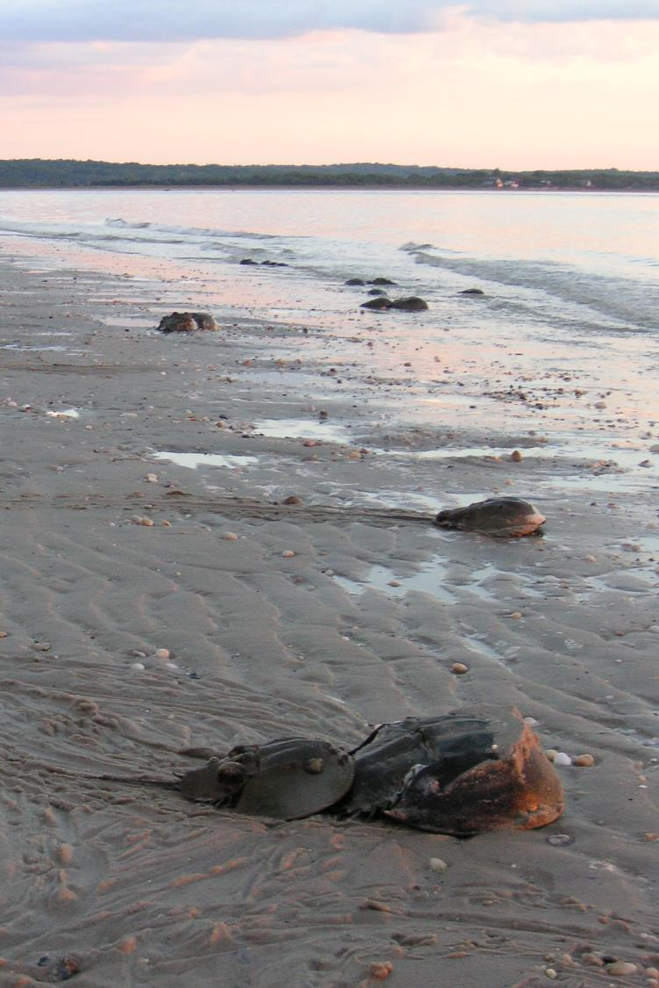



Long Island Sound
2025 Comprehensive Conservation and Management Plan
Picture by Casey Personius, NYSDEC

Slide 2

Zoom Webinar Features
“Switch to Phone Audio” if your computer’s speakers are not working
Technical difficulties
Questions for Presenters
Closed Captions
This webinar is being recorded
Chat ERG Zoom host (Paola Felix) with technical issues.
Use the Q&A box to leave questions for presenters.
Autogenerated closed captions are available through Zoom.
Notes:
Before we get started, please note that this webinar will be recorded. Please take a moment to familiarize yourself with the Zoom features that can be used during today’s webinar. This image shows the features available on your Zoom control panel, which is the black bar at the bottom of your zoom window. First, if your computer speakers are not working you can switch to phone audio under “audio settings.” If you have any other technical difficulties, please use the chat box to message Paola Felix, the “Zoom Host.” [Drop in chat] You can leave questions for presenters throughout the presentation by clicking on the “Q&A” icon in your control bar, and typing in a question. Panelists will answer selected audience questions after the end of today’s presentation.

Slide 3
Agenda
Overview of the Long Island Sound Study
Overview of the 2025 Comprehensive Conservation and Management Plan (CCMP) Revision Process
Overview of Draft CCMP Content
Instructions for Public Comment
Q & A
    Clarifying questions on how to participate in the public comment period.
    Clarifying questions about the draft content of the CCMP.
    We will not be accepting comments on the draft contents of the CCMP during this webinar.
Notes:
ERG Facilitator: Thanks again for joining today’s public information webinar about the Long Island Study’s Draft Comprehensive Conservation and Management Plan (CCMP). My name is ________, I will be facilitating today’s webinar. As you may know, the draft CCMP is currently open for public comment. During today’s webinar, we will be providing background and guidance to help you all participate in the providing public comment. We will start with background on the Long Island Sound Study, provide background on the purpose and goals of the CCMP, present an overview of draft CCMP contents, and provide instructions for how to provide your feedback on the draft plan by participating in public comment. We will conclude the session with a Q&A session with today’s presenters. As mentioned previously, you may use the Q&A box to ask questions throughout presentations. Select questions will be answered at the end of all presentations. We are not accepting comments or feedback on the draft CCMP during today’s webinar – you will learn more about how to provide comments soon. We are accepting (1) clarifying questions on how to participate in the public comment period or (2) clarifying questions about the draft content of the CCMP.

Slide 4
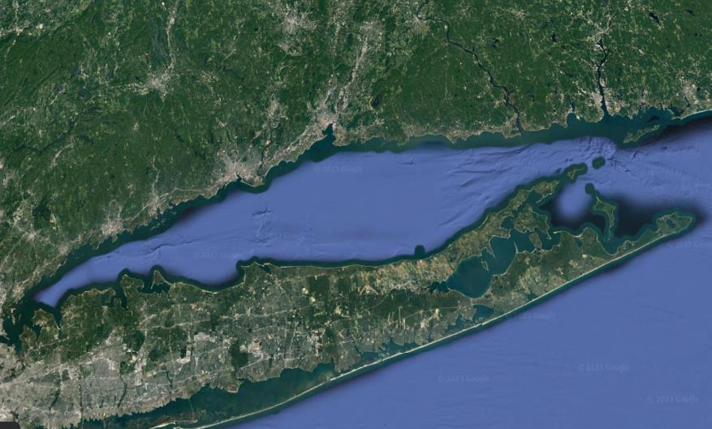
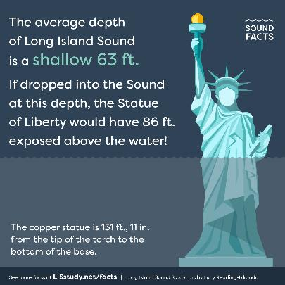













Long Island Sound
The Race reaches depths of 350 feet!
110 miles long
21 miles
Notes:
110 miles long, 21 miles at its widest point, and 1300 square mi in area. Over 600 mi of coastline. LIS is an estuary, or a place where salt water and fresh water mix. 90% of FW comes from 3 rivers in CT, the Housatonic, Connecticut and Thames Rivers. [On LI, the Nissequogue is the only river that flows north, we contribute FW through our GW.]
The Sound has openings to the sea at both its western end through its connection with the East River and at its eastern end at the Race.
[SW from Atlantic Ocean through the eastern part of LIS. The East R also is connected to LIS, but the W in this area sloshes back and forth (and is not freshwater...it is SW because it is the connection between NY Harbor and LIS).]

Slide 5

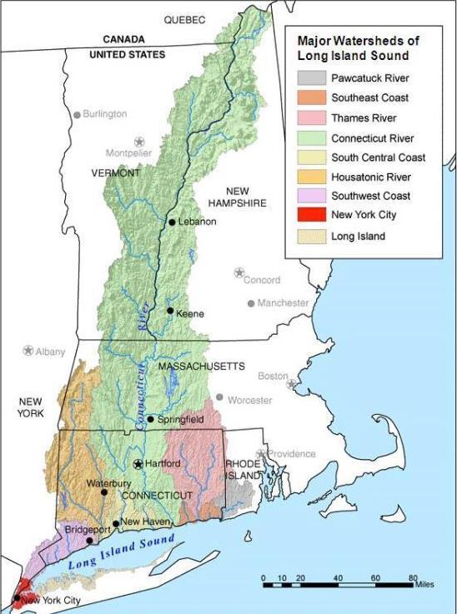
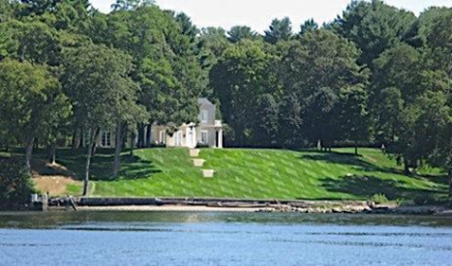
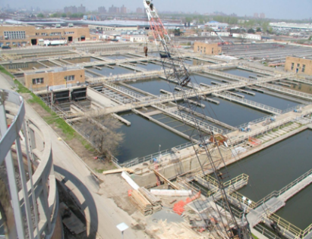
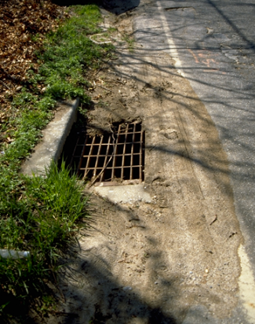
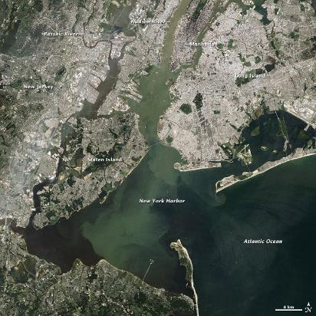
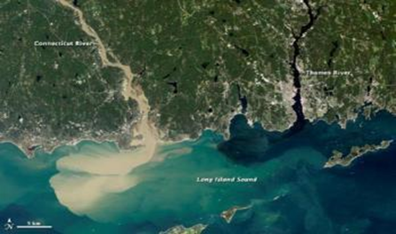
The Long Island Sound watershed
Notes:
In total, the Long Island Sound watershed (or drainage basin) drains an area of more than 16,000 square miles, covering virtually the entire state of Connecticut, portions of New York, Rhode Island, Massachusetts, Vermont, and New Hampshire as well as a small area at the source of the Connecticut River in Quebec.

Slide 6














LISS Partnership Overview
Sponsors
Partners
Notes:
Mark’s note: I propose a new slide three to identify the partners of the program (we have a logo slide) and a simple structure. Who is this LISS? Also be clear to mention that Congress created and authorized the program purpose.
EPA, New York, and Connecticut formed the Long Island Sound Study (LISS) in 1985, a bi-state partnership consisting of federal and state agencies, user groups, concerned organizations, and individuals dedicated to restoring and protecting the Sound. With the Clean Water Act Amendments in 1987, Section 320 of the Act officially established a National Estuary Program. At the request of the states of Connecticut and New York, Long Island Sound was officially designated an Estuary of National Significance under this new program. Congress created this program and authorized the program to carry out the activities listed under Clean Water Act Sections 119 and 320.
A Management Conference for the Long Island Sound Study was convened in March of 1988.

Slide 7


LISS Coordination
Policy Committee
EPA Region 1 & 2 Administrators, NY/CT Environmental Commissioners
Executive Steering Committee
EPA Division Directors, NYSDEC Assistant Commissioners, CTDEEP Bureau Chief
Management Committee
Federal, state, interstate, & local partners
Science & Technical Advisory Committee
Citizens Advisory Committee
LIS Program Office & Implementation Team
Technical Work Groups
Cross-section of stakeholder groups
Transmits stakeholder concerns
Provides advice on public education activities
Communicates with constituencies
Program Coordination
Project Management
Committee & Workgroup Support
Climate Change & Sentinel Monitoring
Environmental Justice
Habitat Restoration & Stewardship
Communications, Outreach & Engagement
Nitrogen Coordination
Sustainable & Resilient Communities
Watersheds & Embayments
Water Quality Monitoring
Federal Partners Coordination
Academia, scientific, technical organizations that counsels on scientific and technical issues
Notes:
CT Dept. of Energy and Environmental Protection

Slide 8
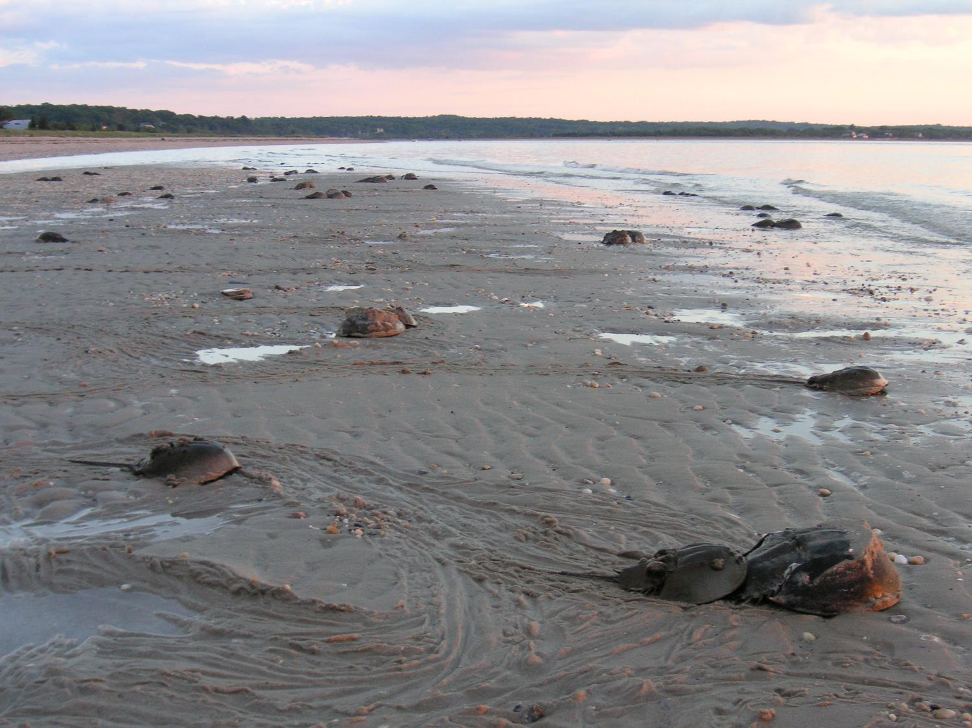
Why we’re here:
The 2025 Comprehensive Conservation and Management Plan (CCMP) has been published for 60-day public comment from September 23 – November 22, 2024.
Picture by Casey Personius, NYSDEC

Slide 9
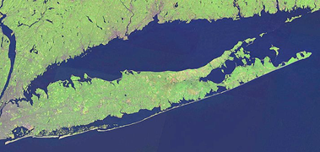
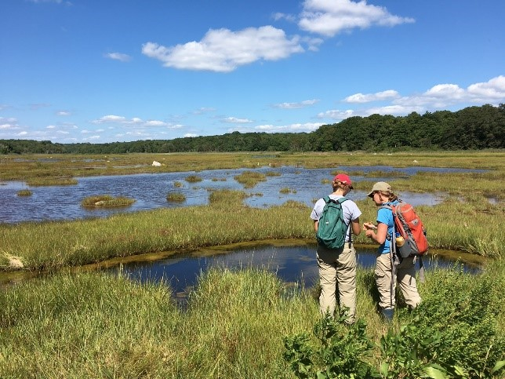
Comprehensive Conservation and Management Plan
The Long Island Sound Comprehensive Conservation and Management Plan (CCMP) outlines goals, objectives, and actions to restore and maintain the health of Long Island Sound and its watershed (the lands and waterways that drain into the Sound).
Who uses it? The Long Island Sound Study (LISS) uses the CCMP to guide its conservation work around Long Island Sound.
Bottom image courtesy of Dr. Beth Lawrence, UConn
Notes:
Consider mentioning that:
LISS is a bi-state partnership consisting of federal and state agencies, user groups, concerned organizations, and individuals dedicated to restoring and caring for the Sound and its watershed.
Address your organization's relationship to LISS
The CCMP addresses areas such as: water quality, habitat and wildlife conservation, coastal resiliency, and environmental stewardship and education.
Some of the work LISS does on the ground as relevant to your audience: habitat restoration, environmental education, water quality monitoring, green infrastructure installations, assistance with resilience planning, etc.

Slide 10
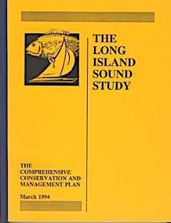
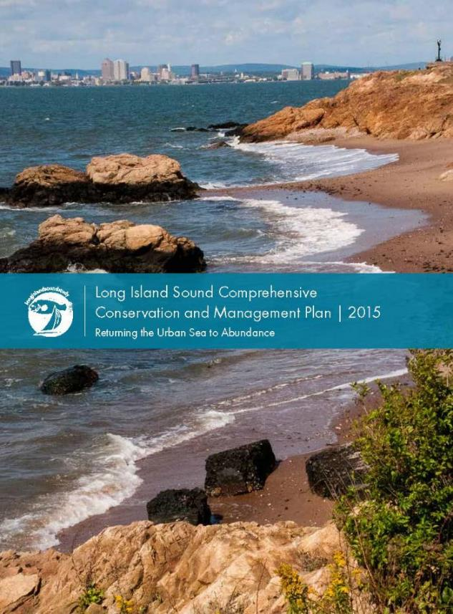
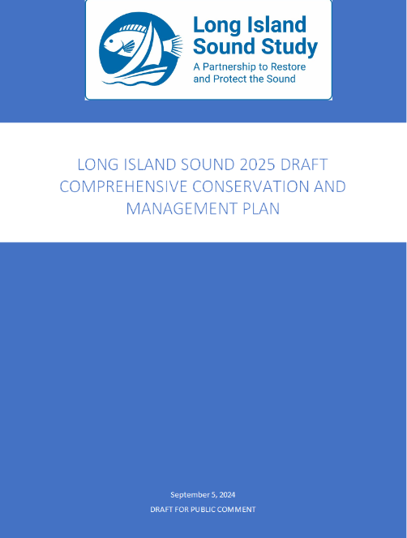
The Plan
1994 Management Plan
2015 Revision
2025 Revision
Notes:
2015 Comprehensive Conservation and Management Plan sets the course for the next 20 years, with 20 ecosystem targets to achieve. Maintained emphasis on water quality and habitat protection and restoration and added emphasis on public involvement and engagement, climate resiliency and environmental justice.

Slide 11
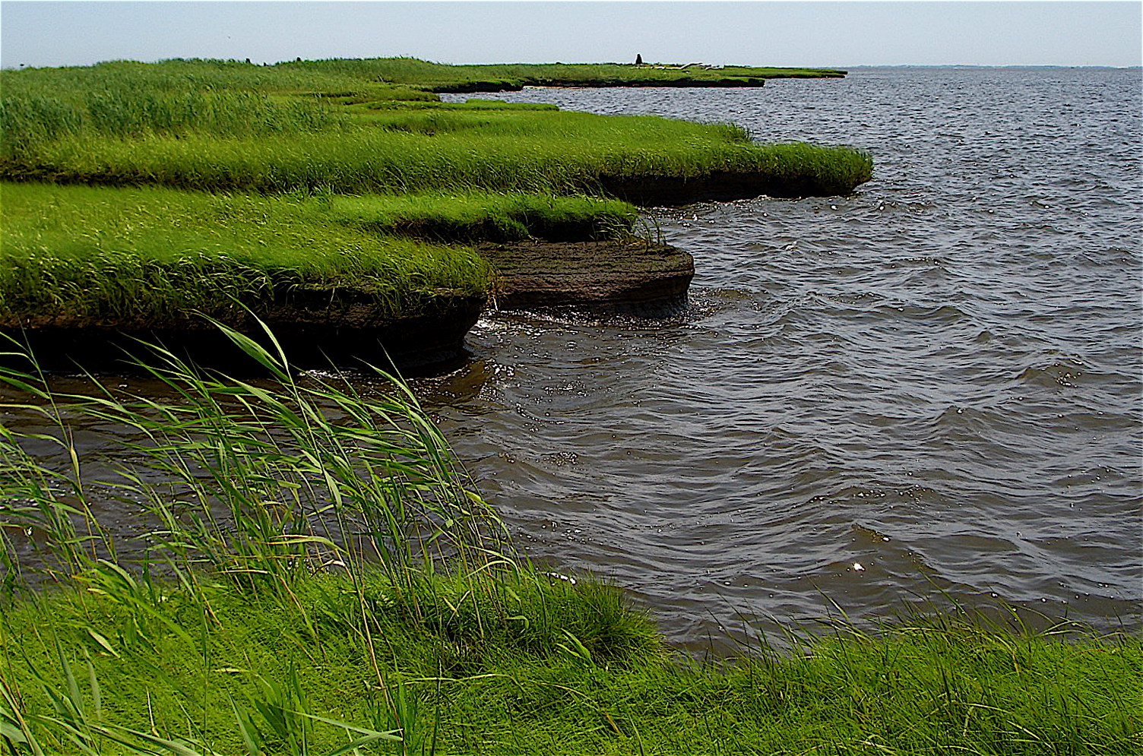
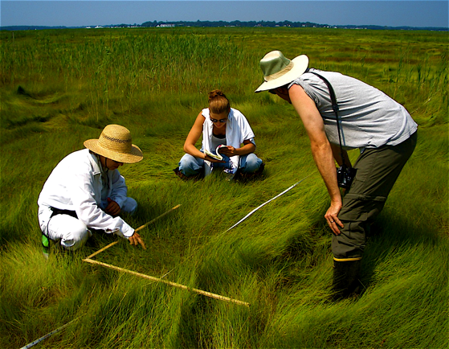
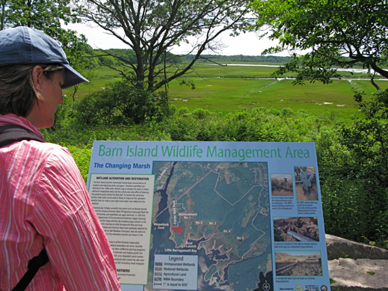
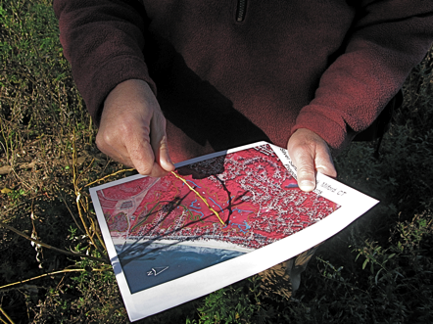
To date, LISS partners have restored over 2102 acres of coastal habitat and
opened over 429 river miles for migratory fish passage.
Since the 2000 nitrogen TMDL , CT and NY cut more than 47 million pounds of nitrogen annually from point sources alone.
Nitrogen management actions have decreased the five-year rolling average in the maximum area of hypoxic waters by 54 percent compared to the pre-2000 average of 205 square miles.
The LIS Stewardship Initiative is working to protect and enhance 33 flagship coastal preserve sites in Connecticut and Long Island, New York; promoting public access, education and passive recreation.
Notes:
Numbers are up to 2020

Slide 12
The Long Island Sound CCMP is being revised!
Community Input Needed
New plan for 2025. Outlines goals, objectives, and actions to restore and maintain the health of Long Island Sound and its watershed.
Will set objectives for the next ten years and actions for the next five years.
Opportunity to expand engagement and commitment.

Slide 13
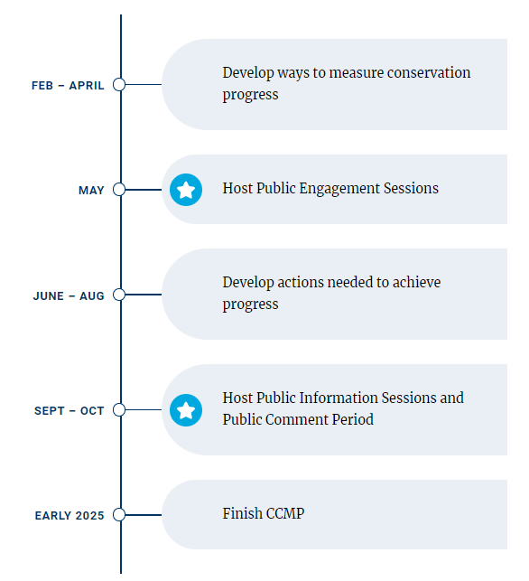

How to get involved
Community Input Needed
Public meetings:
Spring 2024 - In-person, Hybrid, and virtual meetings completed
Fall 2024 - See the completed draft plan and provide feedback
Check the website for updates!
LISstudy.net/plan
Notes:
In the Spring, the LISS held three virtual engagement sessions and three in-person engagement sessions open to the public with the purpose of listening to and collecting thoughts, concerns, and ideas for the plan’s development.
We will present an overview of the CCMP content and provide instruction on how to submit your comments.
A few important notes: LISS partners will be presenting information on what you will find in the completed draft plan. Because we are in the 60-day public comment period of the plan, it is important that we receive all public comments in writing. We will leave time for questions at the end of this presentation, but we will not be taking notes on the comments shared during this information sessions. Instead, we will be encouraging you to submit your written comments so we can have a record of them. The LISS will synthesize and publish all of the public comments we receive during this 60-day public comment period and we will publish a response to every public comment. So it’s important that you provide your input in writing to us during this time.

Slide 14
CCMP Content
Cover
Table of Contents
Section 1: Introduction
Section 2: Vision, Mission, Values, Goals
Section 3: Monitoring Plan
Section 4: Funding Strategy
References
Glossary
Acronyms
Appendix A: Progress Made under 2015 CCMP
Appendix B: Objective and Actions Descriptions
Appendix C: Key to Actions Supplement
Appendix D: Climate Vulnerabilities
Appendix E: Program Authorization and Organizational Structure

Slide 15
CCMP Content
Vision Statement​: Long Island Sound and its watershed have clean waters, healthy habitats, thriving wildlife, resilient coasts, and an engaged public.
Mission Statement​: The LISS leads a collective effort to restore and care for the Sound and its watershed.
Notes:
Start with an overview of what you will find in the plan

Slide 16
CCMP Content
Values:
Actionable Science
Respect and Trust
Environmental Justice
Adaptive and Inclusive Management
Notes:
Values to guide the operation and activities of the program.

Slide 17

CCMP Content
The CCMP contains four overarching goals:
Each goal has:
Objectives - specific outcomes to be achieved by 2035 that will directly contribute to the goal
Actions – broad, strategic activities to be taken in the next five years to achieve an objective

Slide 18
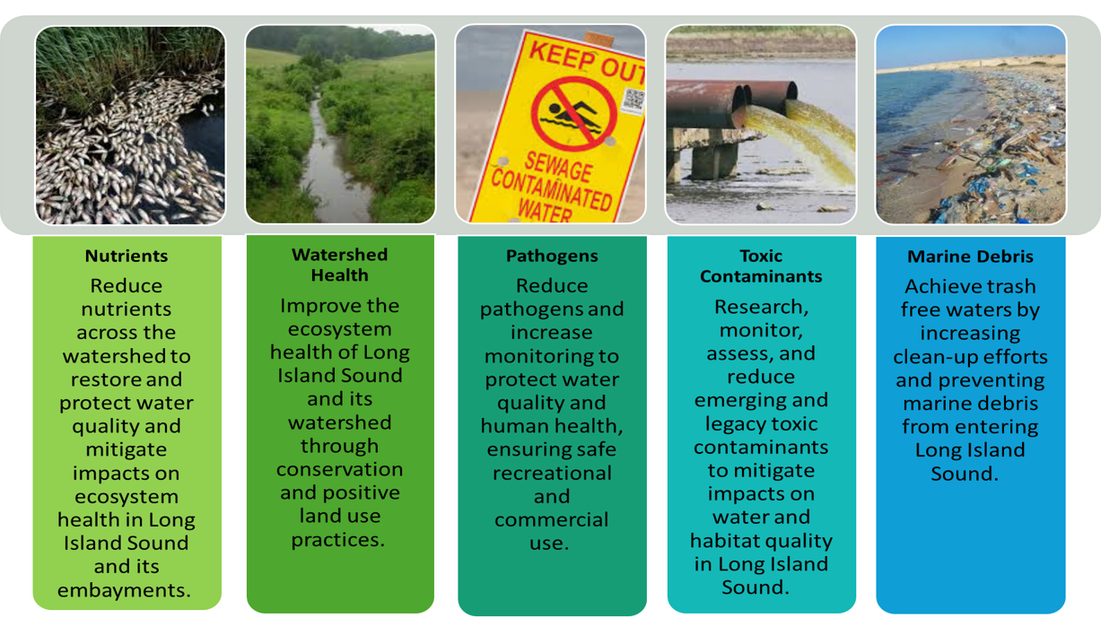
Clean Waters and Healthy Watersheds
Goal 1: Restore and maintain water quality in Long Island Sound and its watershed.

Slide 19
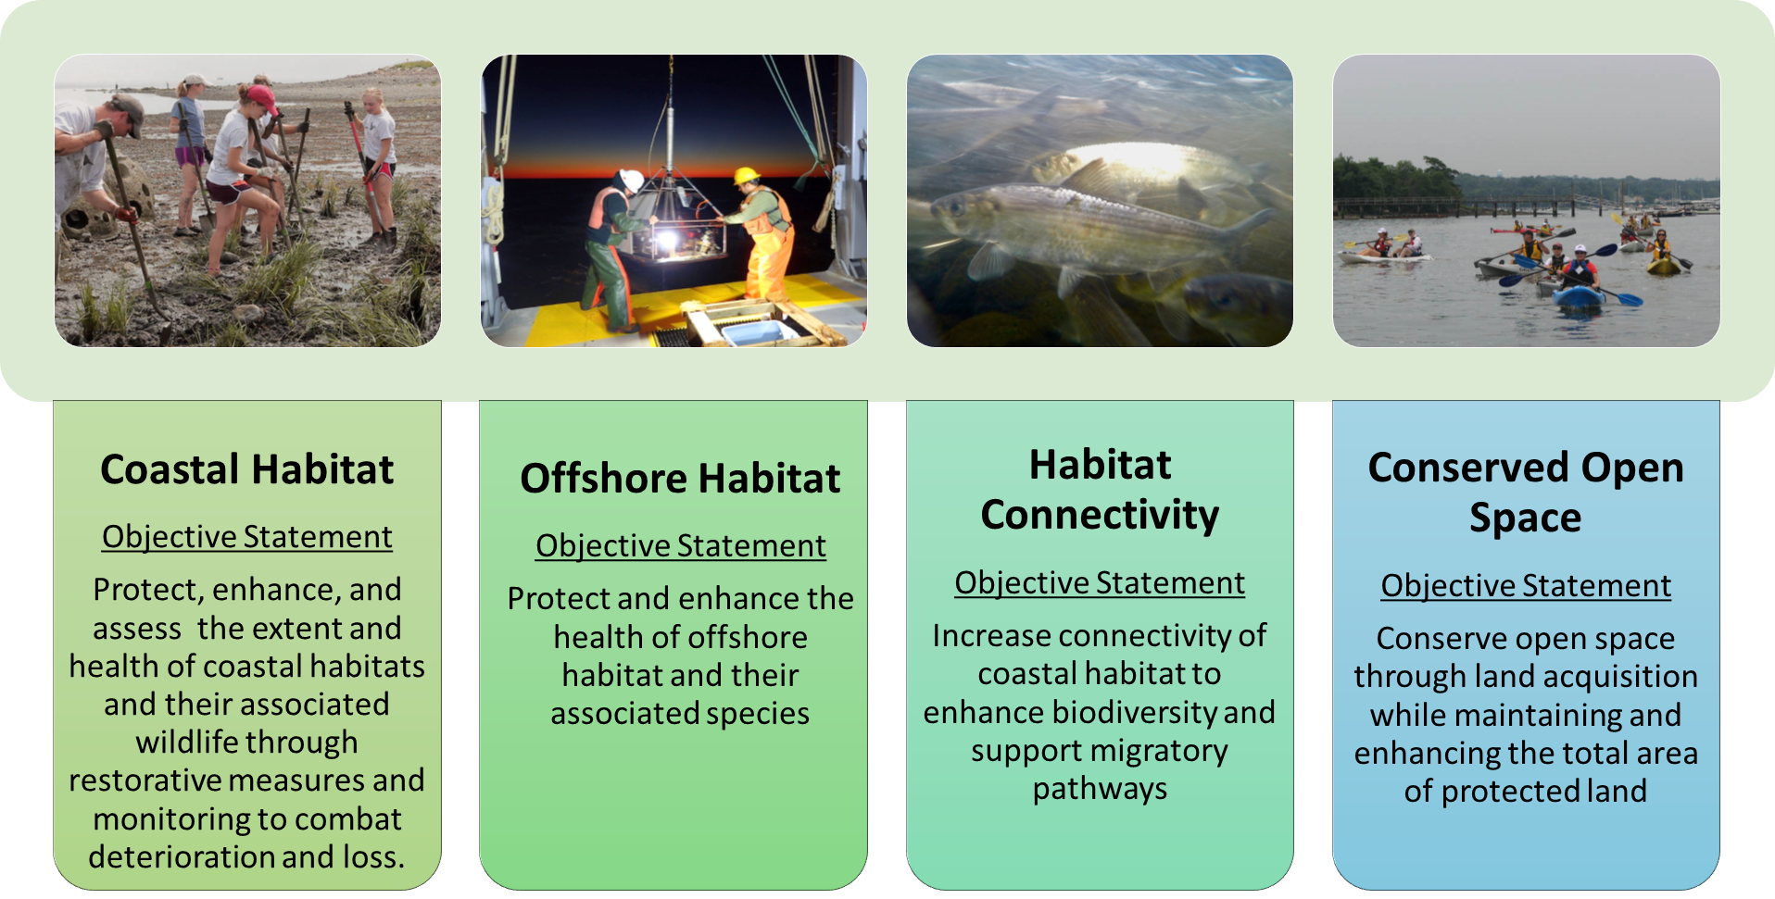
Thriving Habitats and Abundant Wildlife
Goal 2: Restore and protect the health and resilience of habitats and wildlife in Long Island Sound and its ecosystems.
Coastal Habitat
Protect, enhance, and assess the extent and health of coastal habitats and their associated wildlife through restorative measures and monitoring to combat deterioration and loss.
Offshore Habitat
Protect and enhance the health of offshore habitat and their associated species.
Habitat Connectivity
Increase connectivity of coastal habitat to enhance biodiversity and support migratory pathways.
Conserved Open Space
Conserve open space through land acquisition while maintaining and enhancing the total area of protected land.

Slide 20
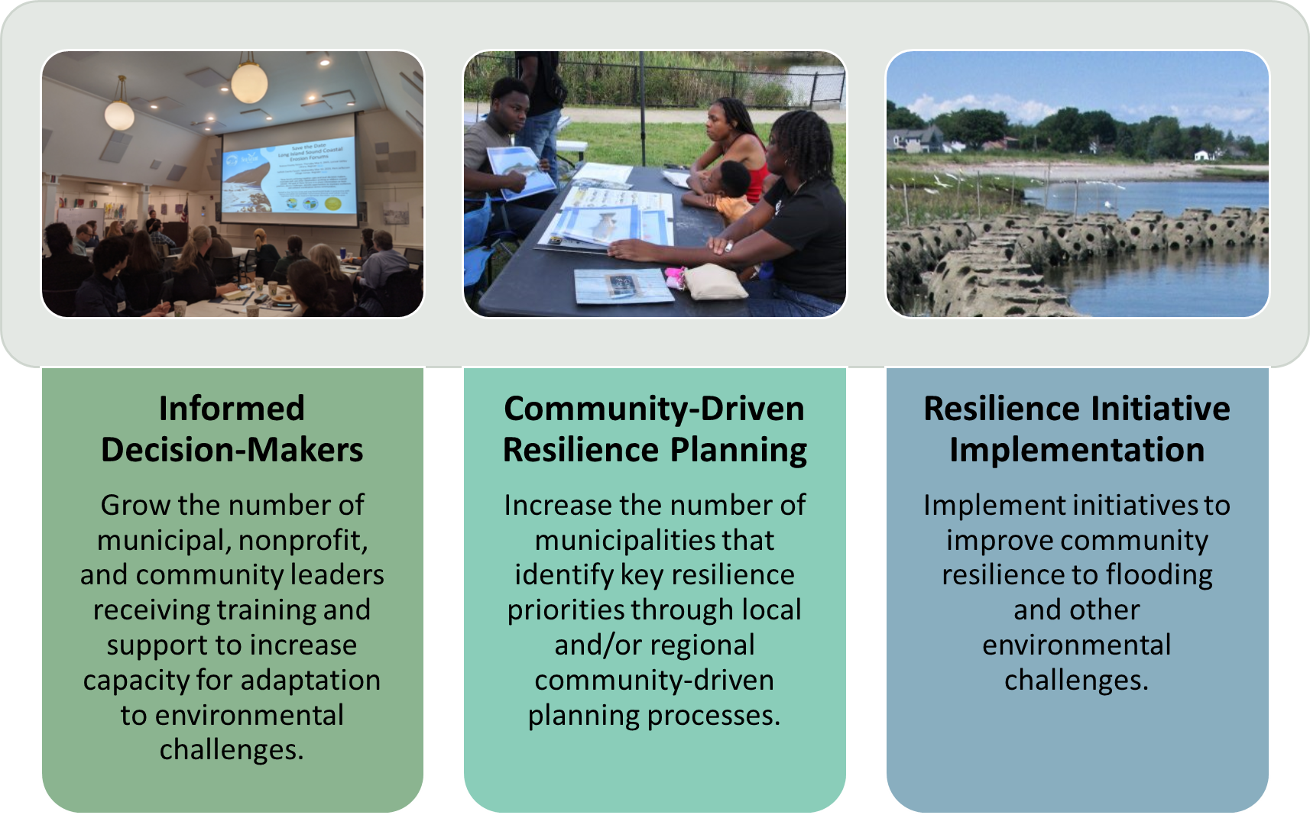
Sustainable and Resilient Communities
Goal 3: Empower communities to plan for and respond to environmental challenges in ways that prioritize well-being for all.

Slide 21
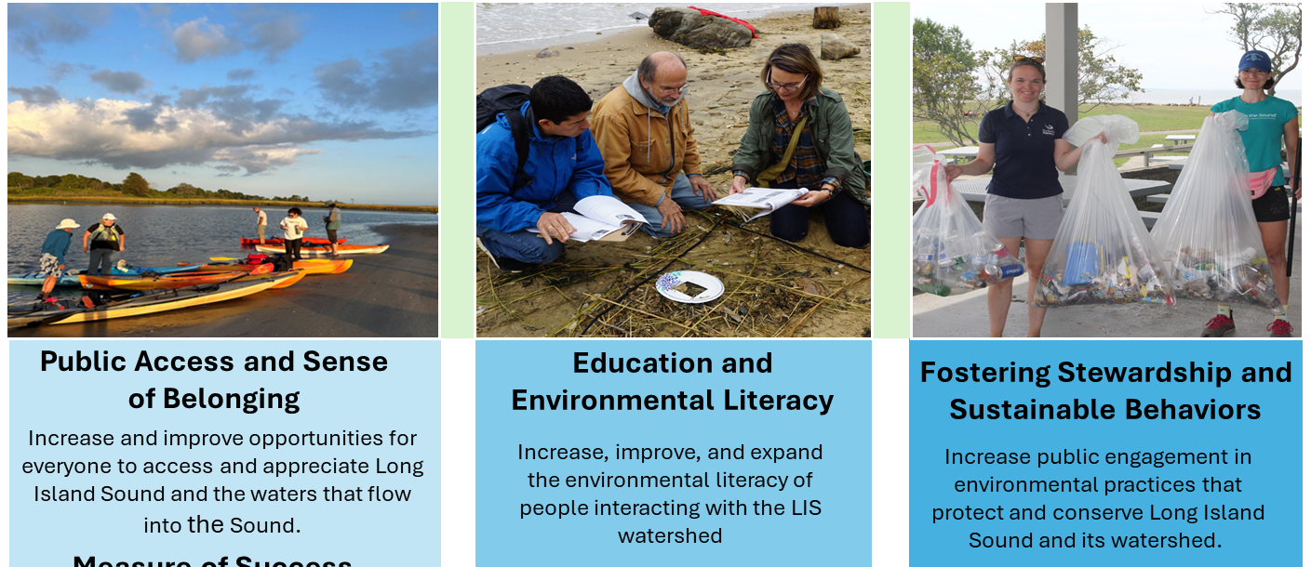
Informed and Engaged Public
Goal 4: Inspire and empower the public to appreciate, value, and protect Long Island Sound and the waters that flow into the Sound.

Slide 22



Time for a new name
The Logo and Name Since the 1980s
1987-2010
2010-2020
2020-2024
Reasons to Rename or Rebrand | Reason to Keep Name
Name is confusing and outdated (LISS is not just a Study) | LISS is a trusted name to our partners
Will be easier for outreach staff to explain what the program does
Removing “Study” will more accurately describe the sweep of the Program’s efforts
Notes:
Has remained virtually the same

Slide 23
New Name
Options for a new name:
Long Island Sound Estuary Partnership (Program)
Long Island Sound Restoration Initiative
Long Island Sound Restoration Partnership (Program)
Notes:
When created, the Management Conference called the partnership the Long Island Sound Study, emphasizing the need to conduct science to better understand how Long Island Sound was impaired and what could be done to restore it. The partnership launched numerous scientific investigations and initiated water quality monitoring programs. The data and information that resulted became the basis for comprehensive restoration efforts. While science is still integral to the program, the Management Conference believes that such studies are in the service of taking action, of coordinated implementation. Therefore, the program is considering changing its name from the Long Island Sound Study to better reflect the commitment to action. Three options are being considered:
Long Island Sound Estuary Partnership;
Long Island Sound Restoration Initiative; or
Long Island Sound Restoration Partnership.
The Management Conference will solicit public comment on which of these three options best characterizes the program today as part of the public review of the draft plan, adopting the new name in the final plan to be released in 2025. The new name will be incorporated throughout the new CCMP and will be adopted by the program.

Slide 24
How to Provide Comments
Fill out our form: CCMP Public Comment Form
Send comments by emailing LISoundPlan2025@gmail.com
Send us your comments anytime from now through November 22, 2024.
Notes:
ERG Facilitator to drop links in the chat

Slide 25
Zoom Webinar Features
Questions for Presenters
Use the Q&A box to leave questions for presenters.
Questions may include:
  Clarifying questions on the public comment process
  Clarifying questions on the draft content.
We are not accepting comments during this webinar – all comments must be entered through the form or email.
Notes:
We are now entering the Q&A portion of today’s webinar. As a reminder, you may continue to leave questions for presenters by clicking on the “Q&A” icon in your control bar, and typing in a question. Panelists will answer selected audience questions now during this facilitated portion.

Slide 26
Questions? Comments?
Check the website for updates!
LISstudy.net/plan
Fill out our form: CCMP Public Comment Form
Send us comments by emailing
LISoundPlan2025@gmail.com
Provide comments by
November 22, 2024!
Picture by Casey Personius, NYSDEC

